Slide 1


Pattern Matching over Noisy Data Streams
Samson Zhou

Slide 2


Finding Structure in Data

Slide 3
Pattern Matching
Finding all instances of a pattern within a string
ABCD
ABCAABCDAACAABCDBCABCDADDDEAEABCDA
Knuth-Morris-Pratt’70

Slide 4


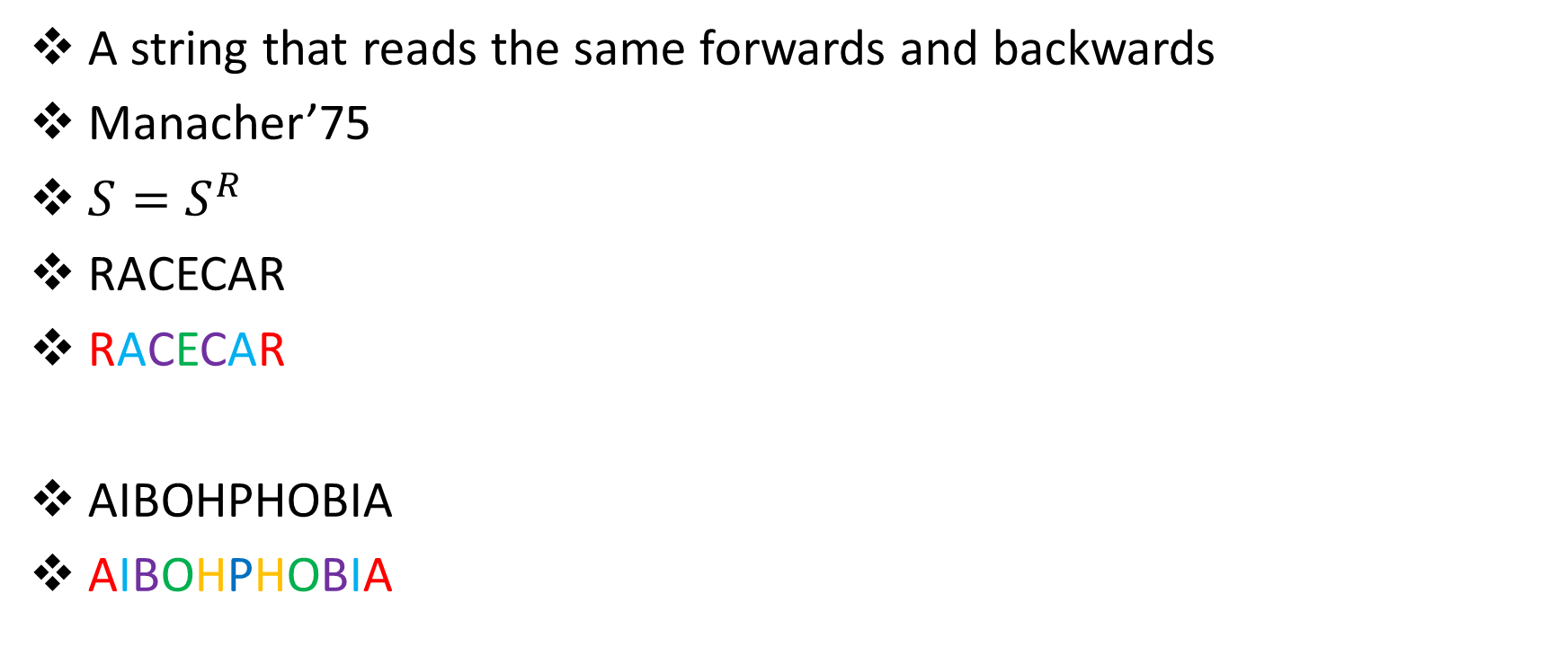
Palindrome
A string that reads the same forwards and backwards
Manacher’75
$S=S^{R}$
RACECAR
RACECAR
AIBOHPHOBIA
AIBOHPHOBIA

Slide 5
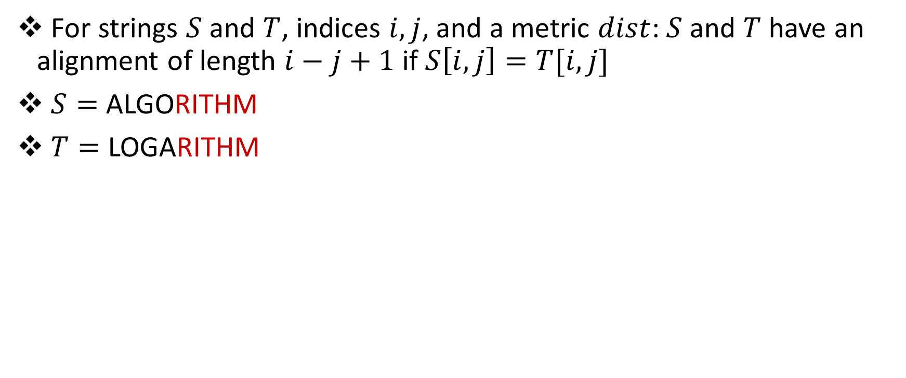
Alignment
For strings $S$and $T$, indices $i,j$, and a metric $dist$: $S$and $T$ have an alignment of length $i−j+1$ if $S\left[i,j\right]=T[i,j]$
$S=$ ALGORITHM
$T=$ LOGARITHM

Slide 6
Periodicity
A portion of a string that repeats
ABCDABCDABCDABCD
ABCDABCDABCDABCD

Slide 7

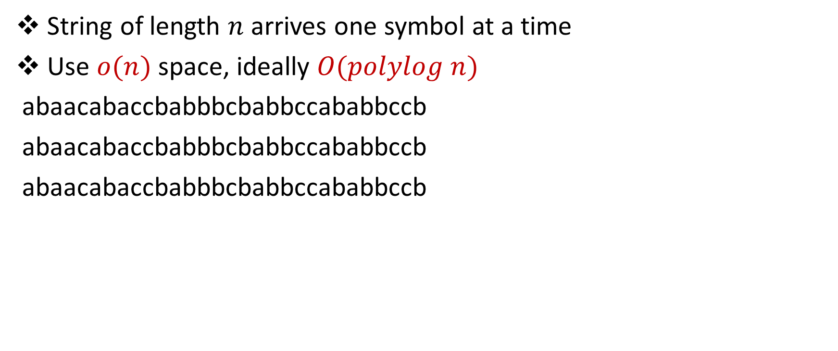
Streaming Model
String of length $n$ arrives one symbol at a time
Use $o(n)$ space, ideally $O(polylog n)$
abaacabaccbabbbcbabbccababbccb
abaacabaccbabbbcbabbccababbccb
abaacabaccbabbbcbabbccababbccb

Slide 8
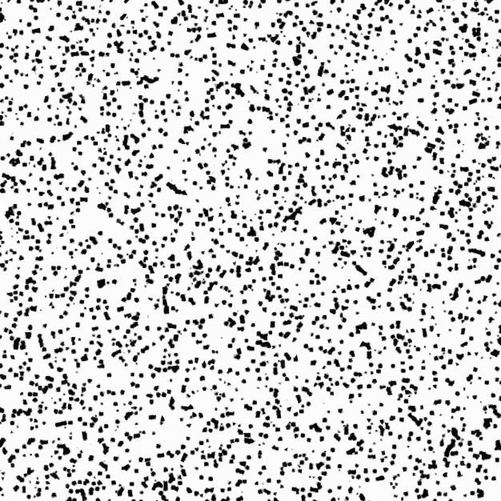
Finding Structure in Noisy Data

Slide 9
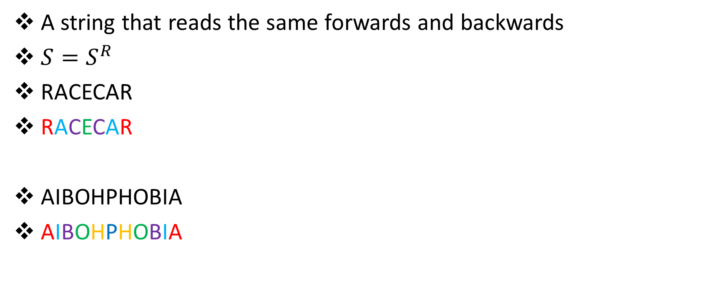
Palindrome
A string that reads the same forwards and backwards
$S=S^{R}$
RACECAR
RACECAR
AIBOHPHOBIA
AIBOHPHOBIA

Slide 10

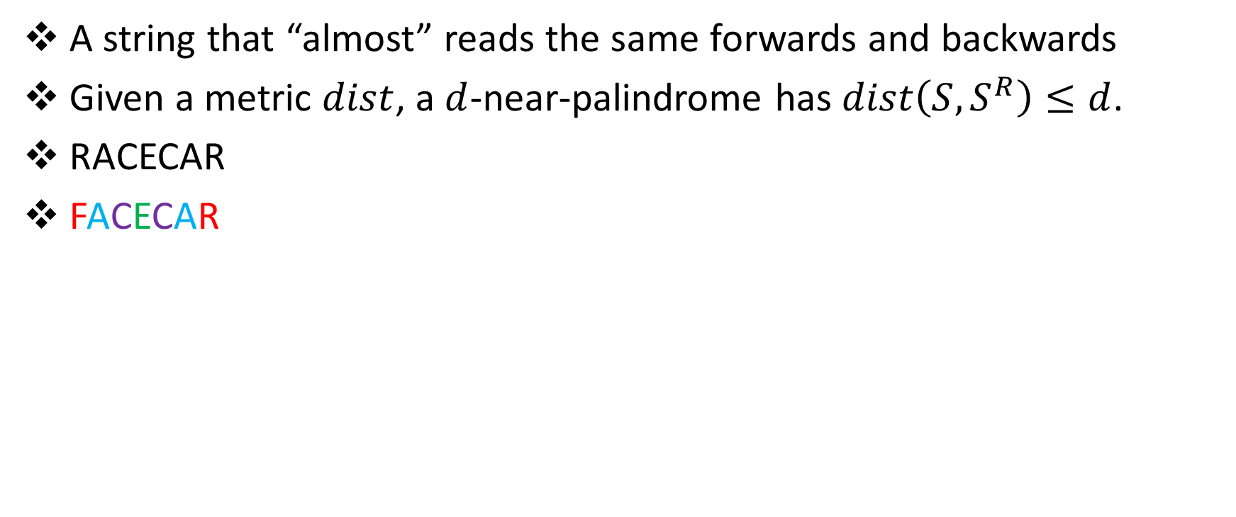
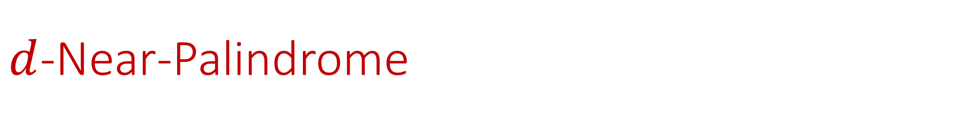
$d$-Near-Palindrome
A string that “almost” reads the same forwards and backwards
Given a metric $dist$, a $d$-near-palindrome has $dist\left(S,S^{R}\right)≤d$.
RACECAR
FACECAR

Slide 11

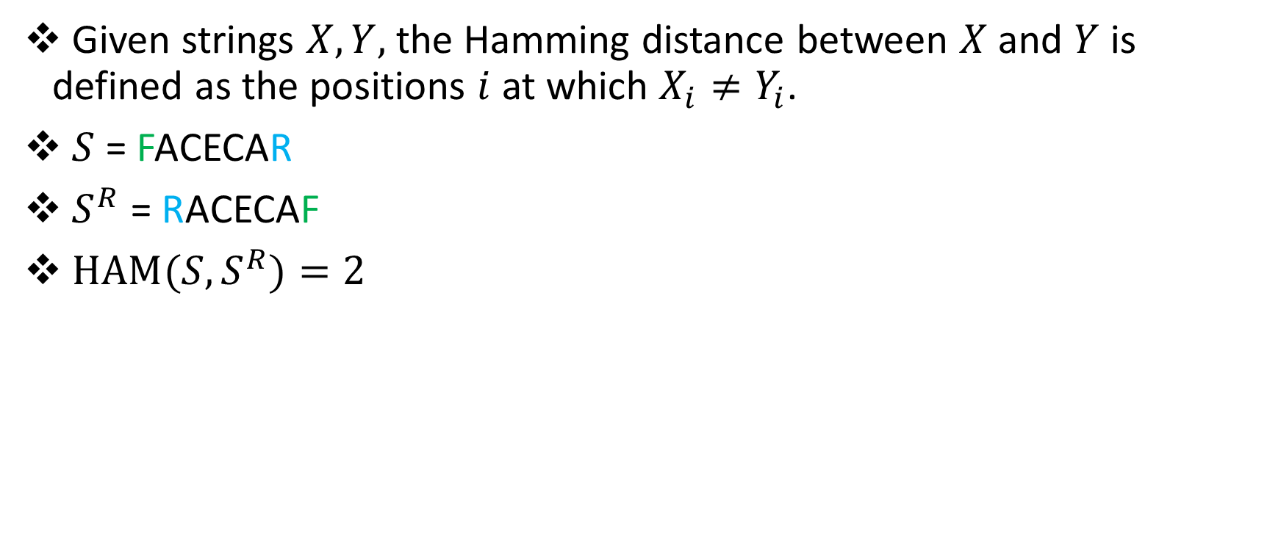
Hamming Distance
Given strings $X, Y,$ the Hamming distance between $X$and $Y$ is defined as the positions $i$ at which $X_{i}≠Y_{i}$.
$S$ = FACECAR
$S^{R}$ = RACECAF
${HAM(S,S}^{R})=2$

Slide 12
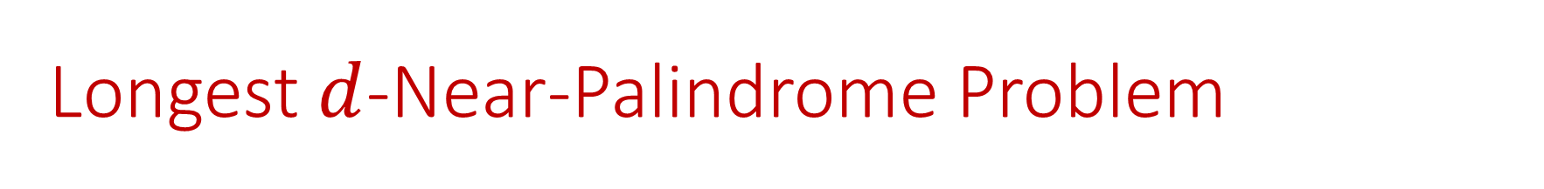
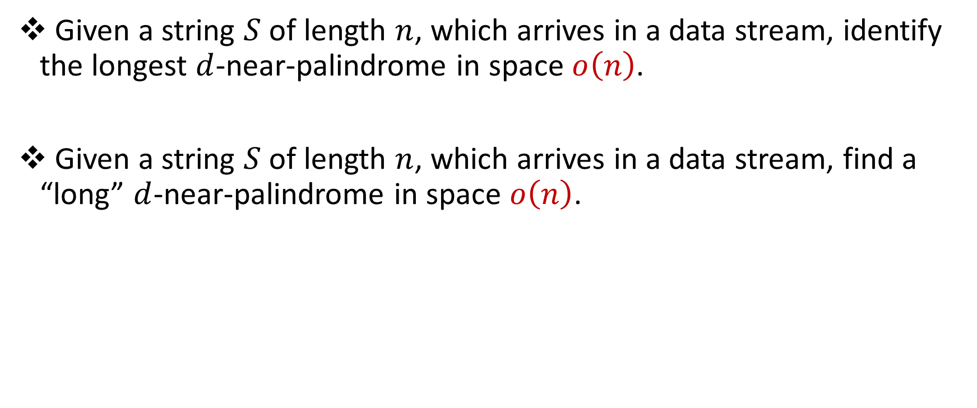
Longest $d$-Near-Palindrome Problem
Given a string $S$ of length $n$, which arrives in a data stream, identify the longest $d$-near-palindrome in space $o\left(n\right)$.
Given a string $S$ of length $n$, which arrives in a data stream, find a “long” $d$-near-palindrome in space $o\left(n\right)$.

Slide 13
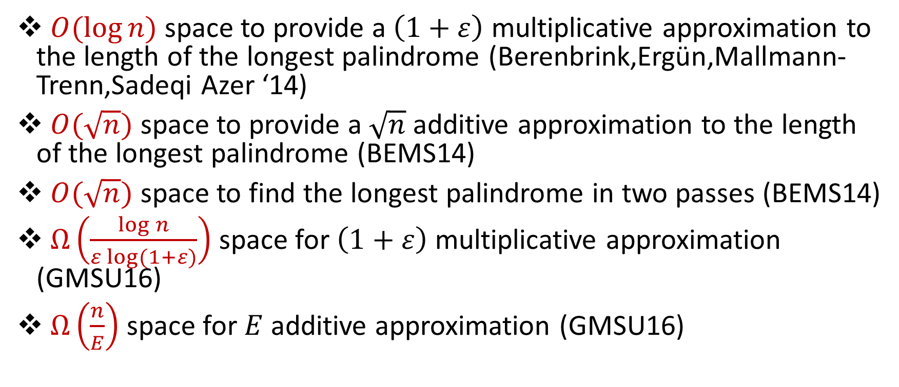
Related Work
$O(\log{n)}$ space to provide a $\left(1+ε\right)$ multiplicative approximation to the length of the longest palindrome (Berenbrink,Ergün,Mallmann-Trenn,Sadeqi Azer ‘14)
$O(\sqrt{n})$ space to provide a $\sqrt{n}$ additive approximation to the length of the longest palindrome (BEMS14)
$O(\sqrt{n})$ space to find the longest palindrome in two passes (BEMS14)
$Ω\left(\frac{\log{n}}{ε log⁡(1+ε)}\right)$ space for $\left(1+ε\right)$ multiplicative approximation (GMSU16)
$Ω\left(\frac{n}{E}\right)$ space for $E$ additive approximation (GMSU16)

Slide 14
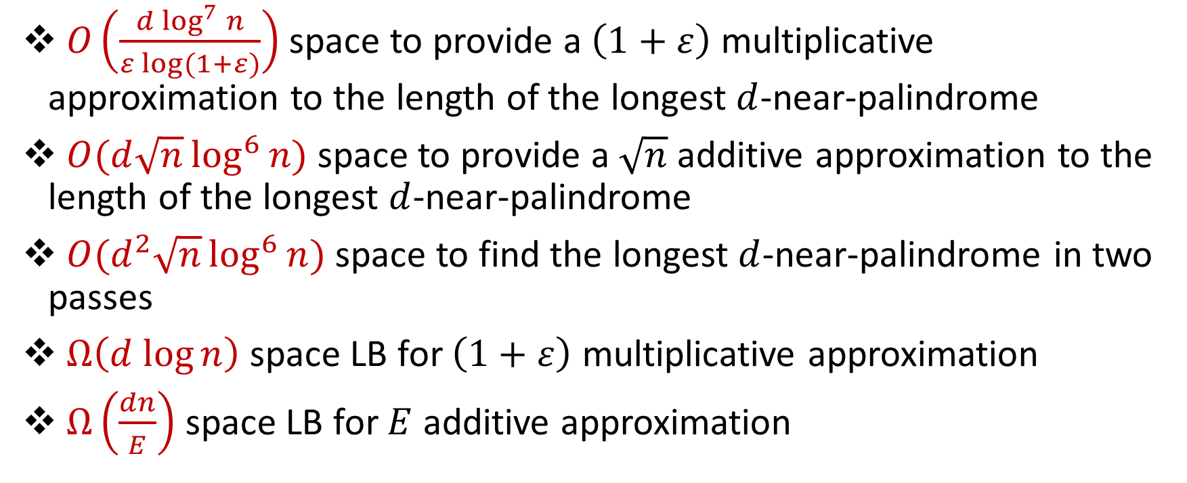
Our results
$O\left(\frac{d \log^{7}{n}}{ε log⁡(1+ε)}\right)$ space to provide a $\left(1+ε\right)$ multiplicative approximation to the length of the longest $d$-near-palindrome
$O(d\sqrt{n}\log^{6}{n})$ space to provide a $\sqrt{n}$ additive approximation to the length of the longest $d$-near-palindrome
$O(d^{2}\sqrt{n}\log^{6}{n})$ space to find the longest $d$-near-palindrome in two passes
$Ω\left(d log{n}\right)$ space LB for $\left(1+ε\right)$ multiplicative approximation
$Ω\left(\frac{dn}{E}\right)$ space LB for $E$ additive approximation

Slide 15
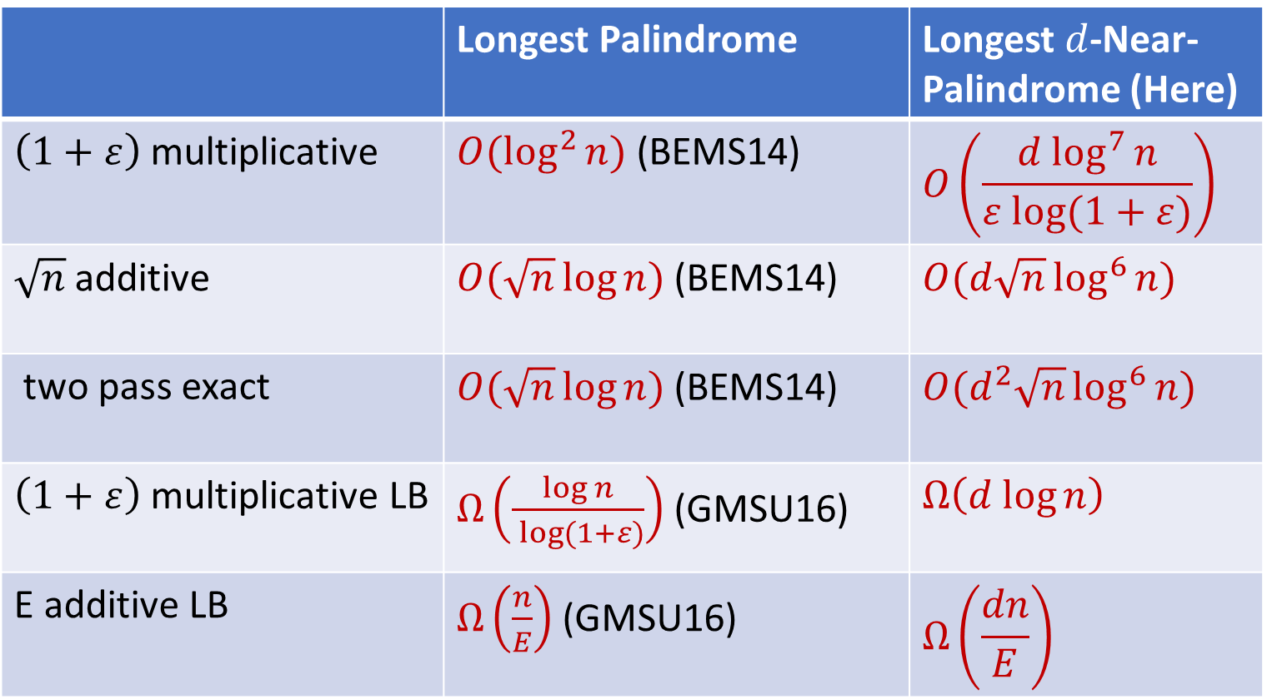
Comparison
 | Longest Palindrome | Longest $d$-Near-Palindrome (Here)
$\left(1+ε\right)$ multiplicative | $O(\log^{2}{n)}$ (BEMS14) | $$O\left(\frac{d \log^{7}{n}}{ε log⁡(1+ε)}\right)$$
$\sqrt{n}$ additive | $O(\sqrt{n}\log{n})$ (BEMS14) | $O(d\sqrt{n}\log^{6}{n})$
two pass exact | $O(\sqrt{n}\log{n})$ (BEMS14) | $O(d^{2}\sqrt{n}\log^{6}{n})$
$\left(1+ε\right)$ multiplicative LB | $Ω\left(\frac{\log{n}}{ log⁡(1+ε)}\right)$ (GMSU16) | $$Ω\left(d log{n}\right)$$
E additive LB | $Ω\left(\frac{n}{E}\right)$ (GMSU16) | $$Ω\left(\frac{dn}{E}\right)$$

Slide 16

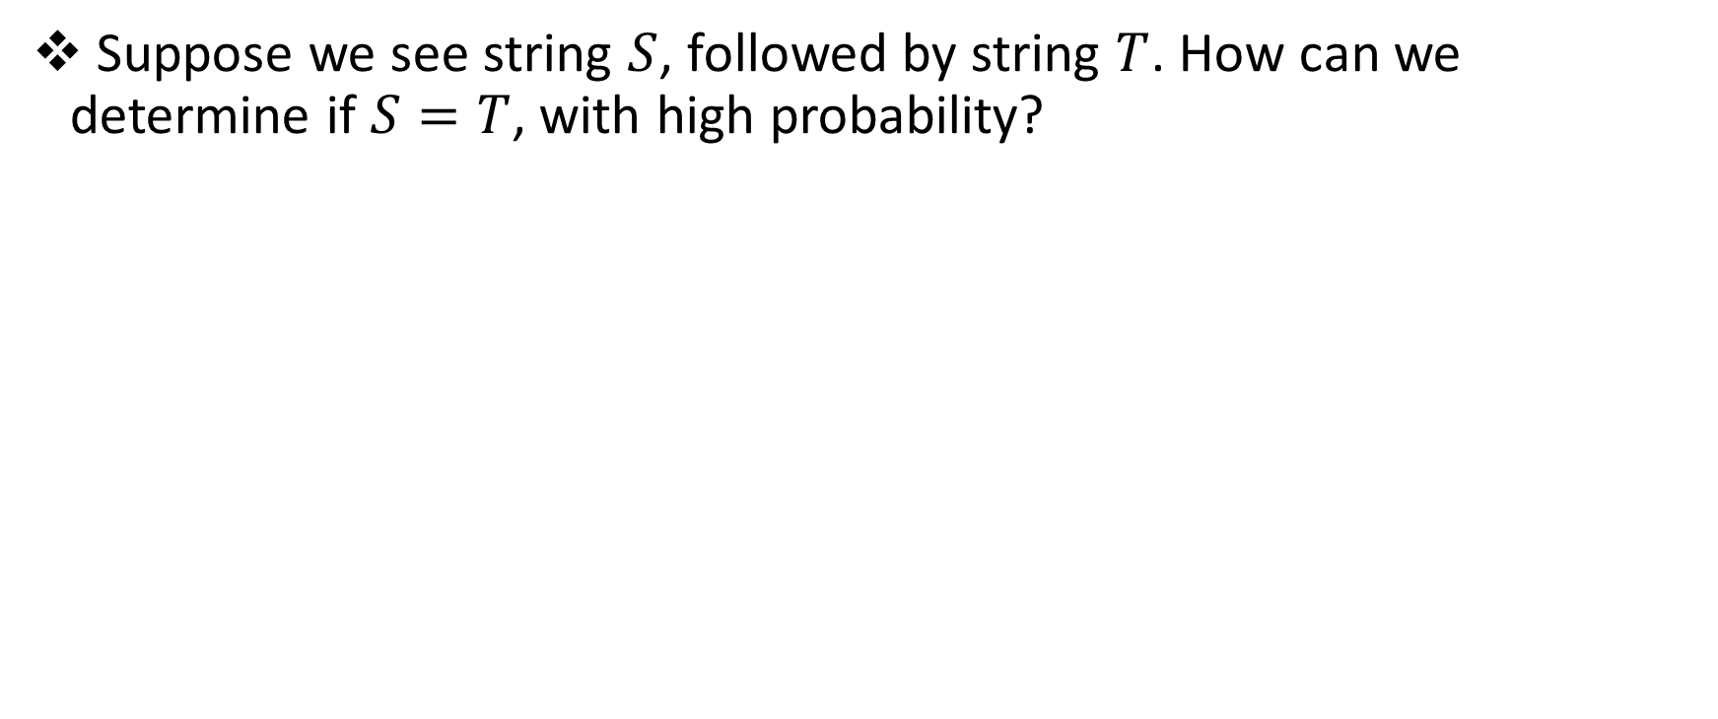
Warm-up
Suppose we see string $S$, followed by string $T$. How can we determine if $S=T$, with high probability?

Slide 17

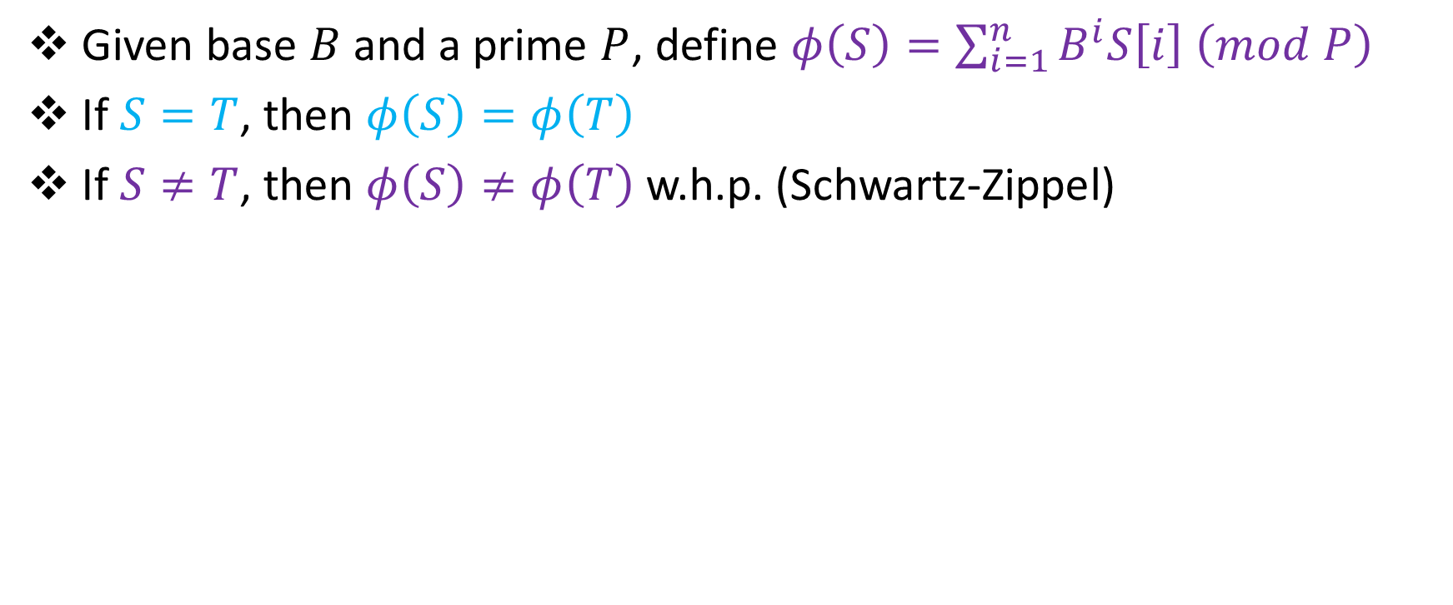
Karp-Rabin Fingerprints
Given base $B$and a prime $P$, define $φ\left(S\right)=\sum_{i=1}^{n}{B^{i}S\left[i\right] \left(mod P\right)}$
If $S=T$, then $φ\left(S\right)=φ\left(T\right)$
If $S≠T$, then $φ\left(S\right)≠φ\left(T\right)$ w.h.p. (Schwartz-Zippel)

Slide 18
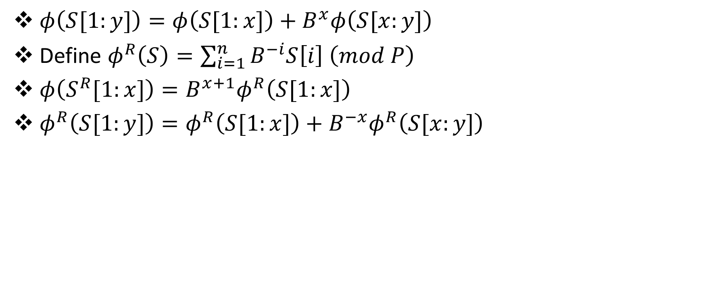
Properties of Karp-Rabin Fingerprints
$φ\left(S[1:y]\right)=φ\left(S[1:x]\right)+B^{x}φ\left(S[x:y]\right)$
Define $φ^{R}\left(S\right)=\sum_{i=1}^{n}{B^{−i}S\left[i\right] \left(mod P\right)}$
$φ\left(S^{R}[1:x]\right)=B^{x+1}φ^{R}\left(S[1:x]\right)$
$φ^{R}\left(S[1:y]\right)=φ^{R}\left(S[1:x]\right)+B^{−x}φ^{R}\left(S[x:y]\right)$

Slide 19


Identifying Palindromes
111101011100001010010101001111101011100001010010101001
111101011100001010010101001111101011100001010010101001

Slide 20

Identifying Near-Palindromes?
111101011100001010010101001111101011100001010010101001
111101011100001010010101001111101011100001010010101001

Slide 21
Identifying Near-Palindromes?
111101011100001010010101001111101011100001010010101001
111101011100001010010101001111101011100001010010101001

Slide 22
Identifying Near-Palindromes? (CFP+16)

Slide 23
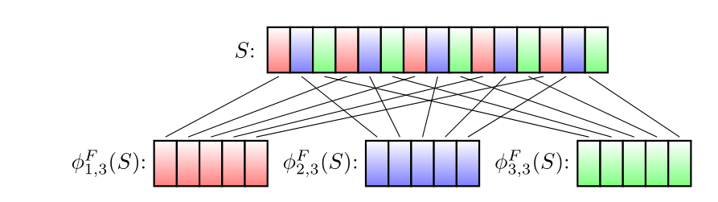
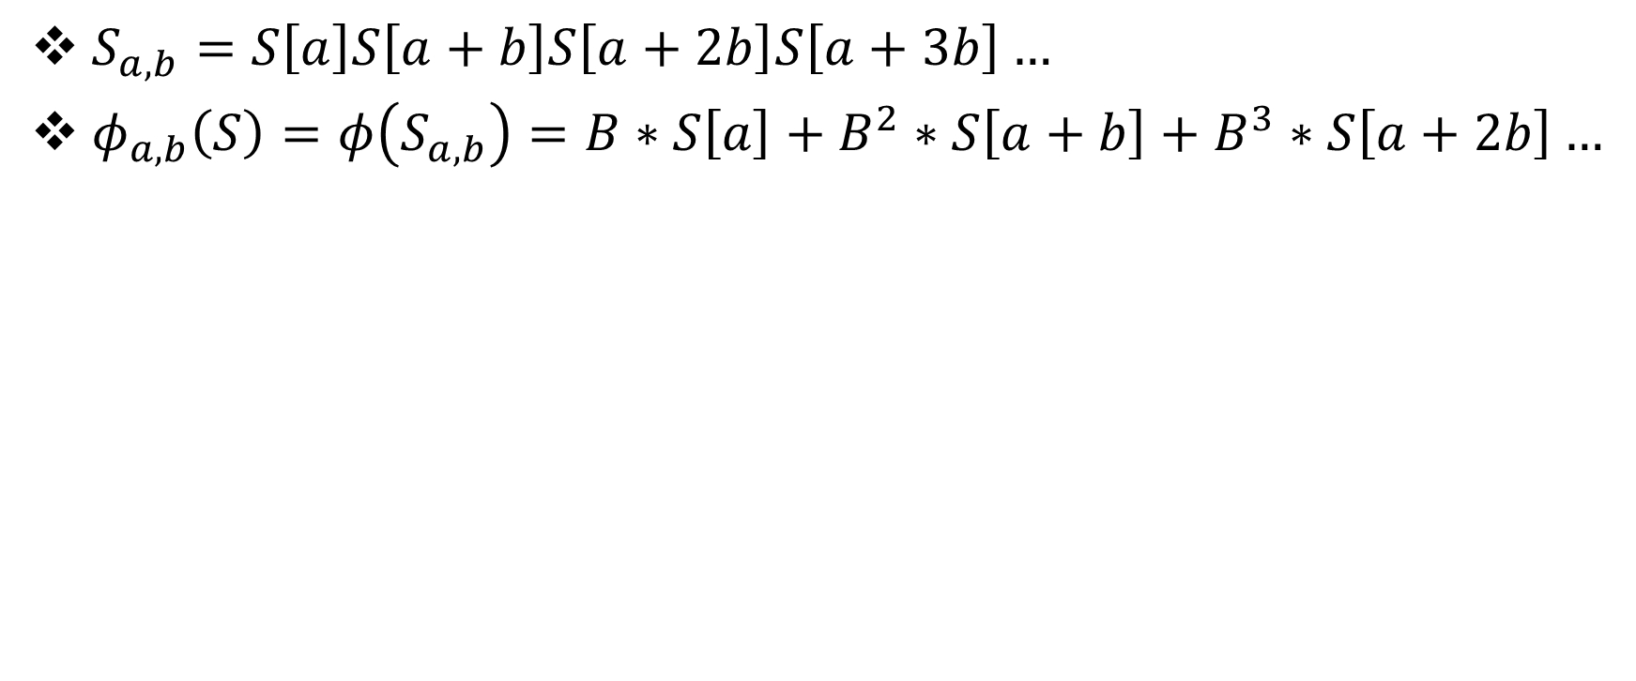
Karp-Rabin Fingerprints for subpatterns
$S_{a,b}=S\left[a\right]S\left[a+b\right]S\left[a+2b\right]S\left[a+3b\right]…$
$φ_{a,b}\left(S\right)=φ\left(S_{a,b}\right)=B∗S\left[a\right]+B^{2}∗S\left[a+b\right]+B^{3}∗S\left[a+2b\right]…$

Slide 24
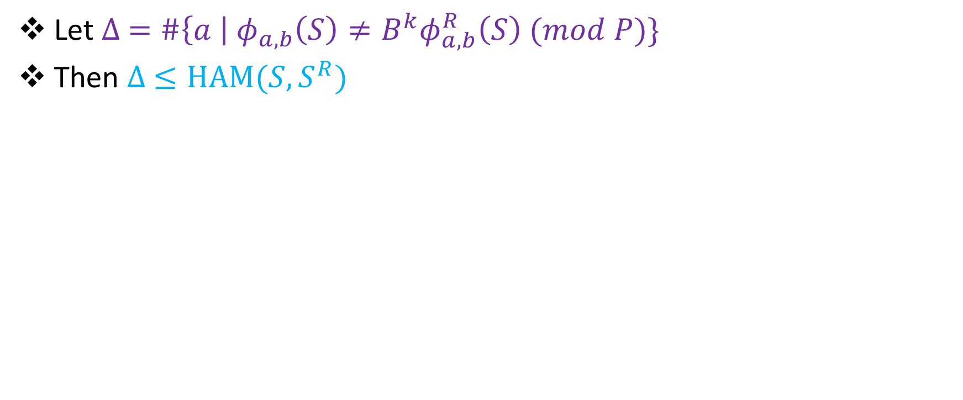
Identifying Near-Palindromes?
Let $∆ =\#\left\{a \right|{ φ}_{a,b}\left(S\right)≠{B^{k}φ}_{a,b}^{R}\left(S\right) (mod P)\}$
Then $∆ ≤HAM(S,S^{R})$

Slide 25

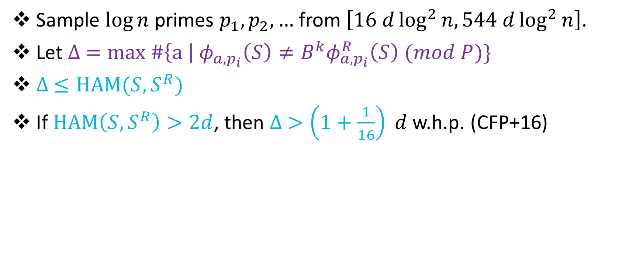
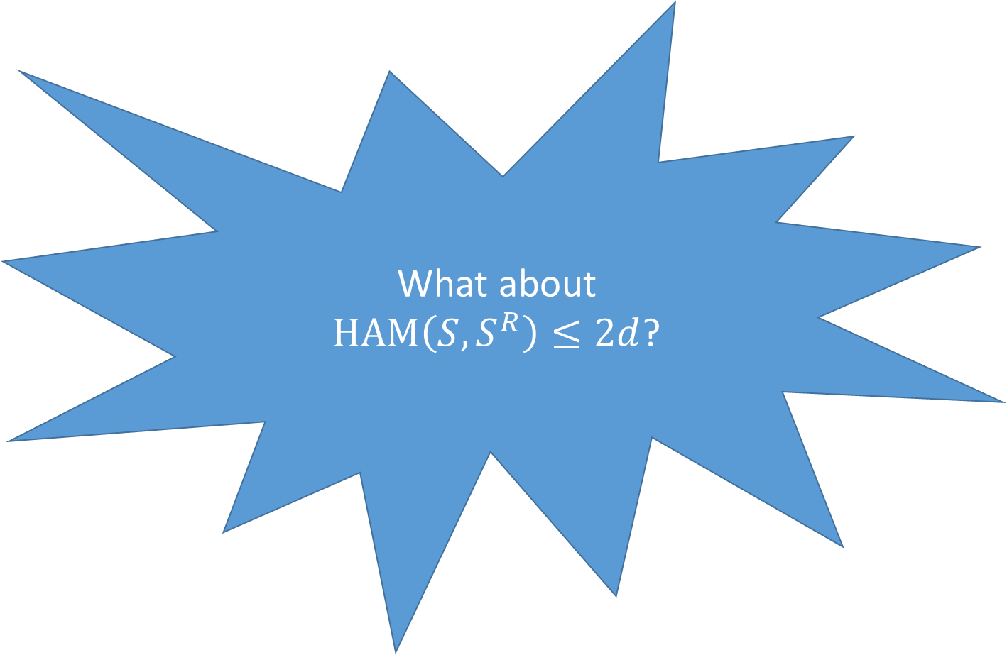
Identifying Near-Palindromes?
What about
$HAM\left(S,S^{R}\right)≤2d$?
Sample $\log{n}$ primes $p_{1},p_{2},…$ from $\left[16 d\log^{2}{n, 544 d\log^{2}{n}}\right]$.
Let $∆ =max \#\left\{a \right|{ φ}_{a,p_{i}}\left(S\right)≠{B^{k}φ}_{a,p_{i}}^{R}\left(S\right) (mod P)\}$
$∆ ≤HAM(S,S^{R})$
If $HAM\left(S,S^{R}\right)>2d$, then $∆ >\left(1+\frac{1}{16}\right) d$ w.h.p. (CFP+16)

Slide 26
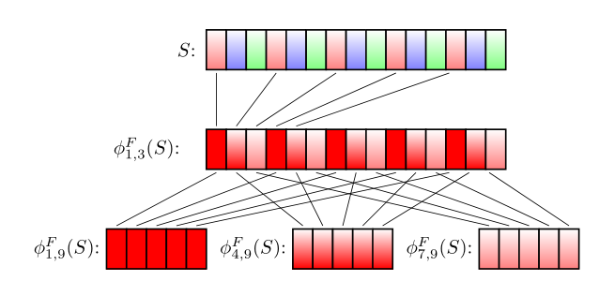
Karp-Rabin Fingerprints for sub-subpatterns

Slide 27

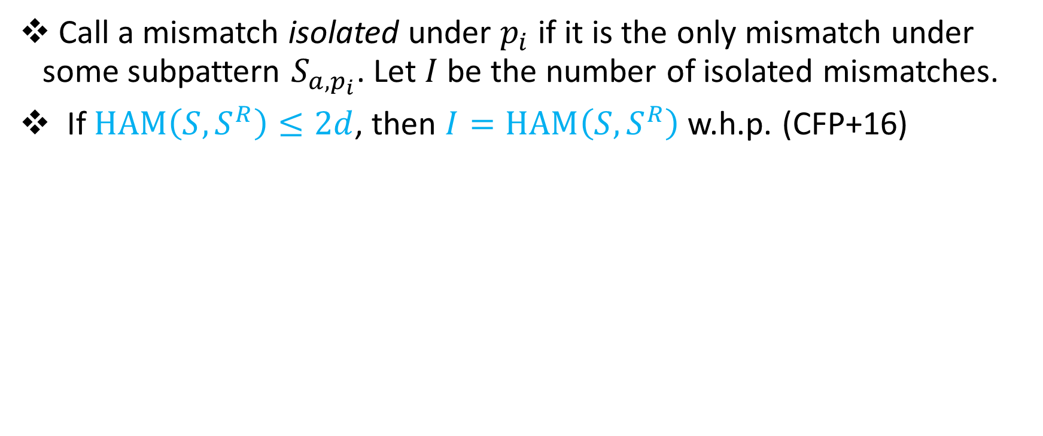
Second level Karp-Rabin Fingerprints
Call a mismatch isolated under $p_{i}$ if it is the only mismatch under some subpattern $S_{a,p_{i}}$. Let $I$ be the number of isolated mismatches.
If $HAM\left(S,S^{R}\right)≤2d$, then $I=HAM\left(S,S^{R}\right)$ w.h.p. (CFP+16)

Slide 28

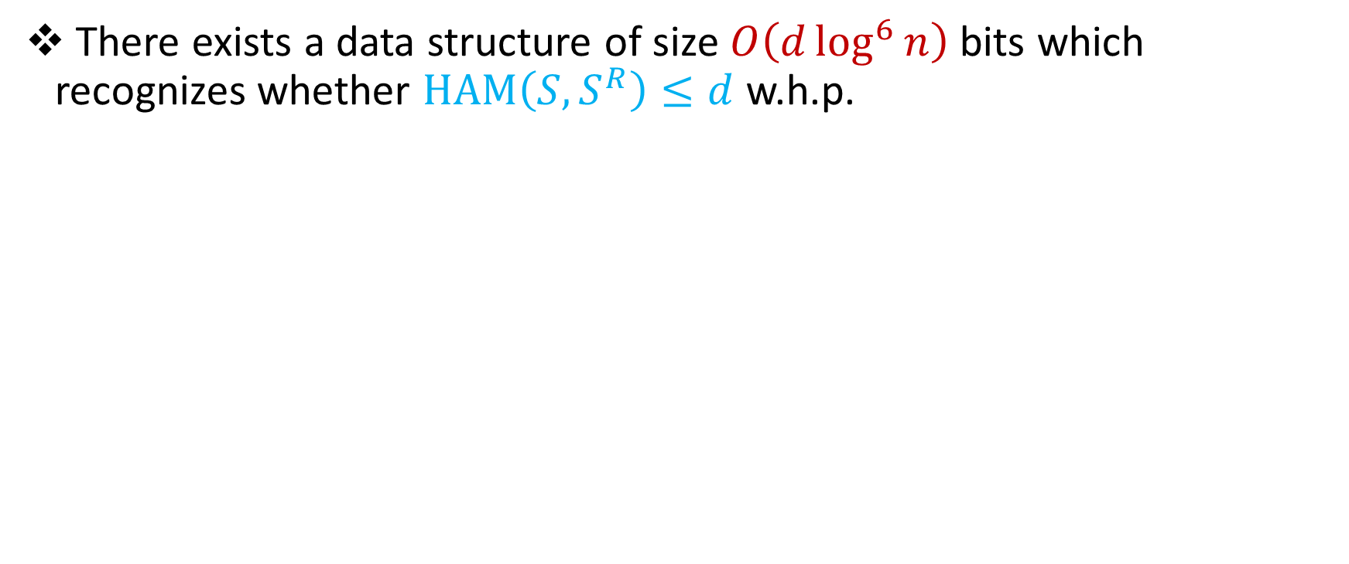
In review
There exists a data structure of size $O\left(d\log^{6}{n}\right)$ bits which recognizes whether $HAM\left(S,S^{R}\right)≤d$ w.h.p.

Slide 29
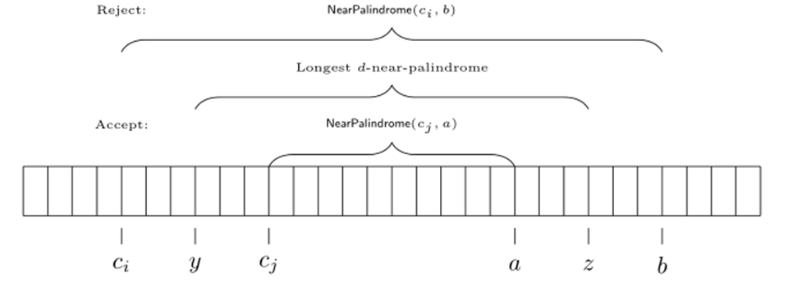
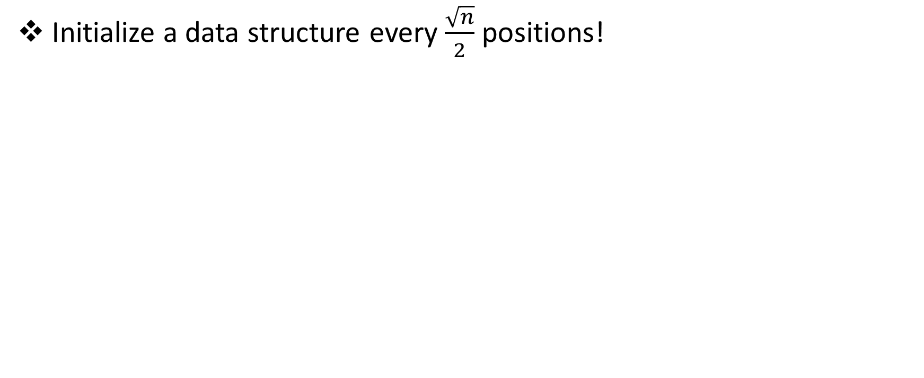
Additive Error Algorithm
Initialize a data structure every $\frac{\sqrt{n}}{2}$ positions!

Slide 30

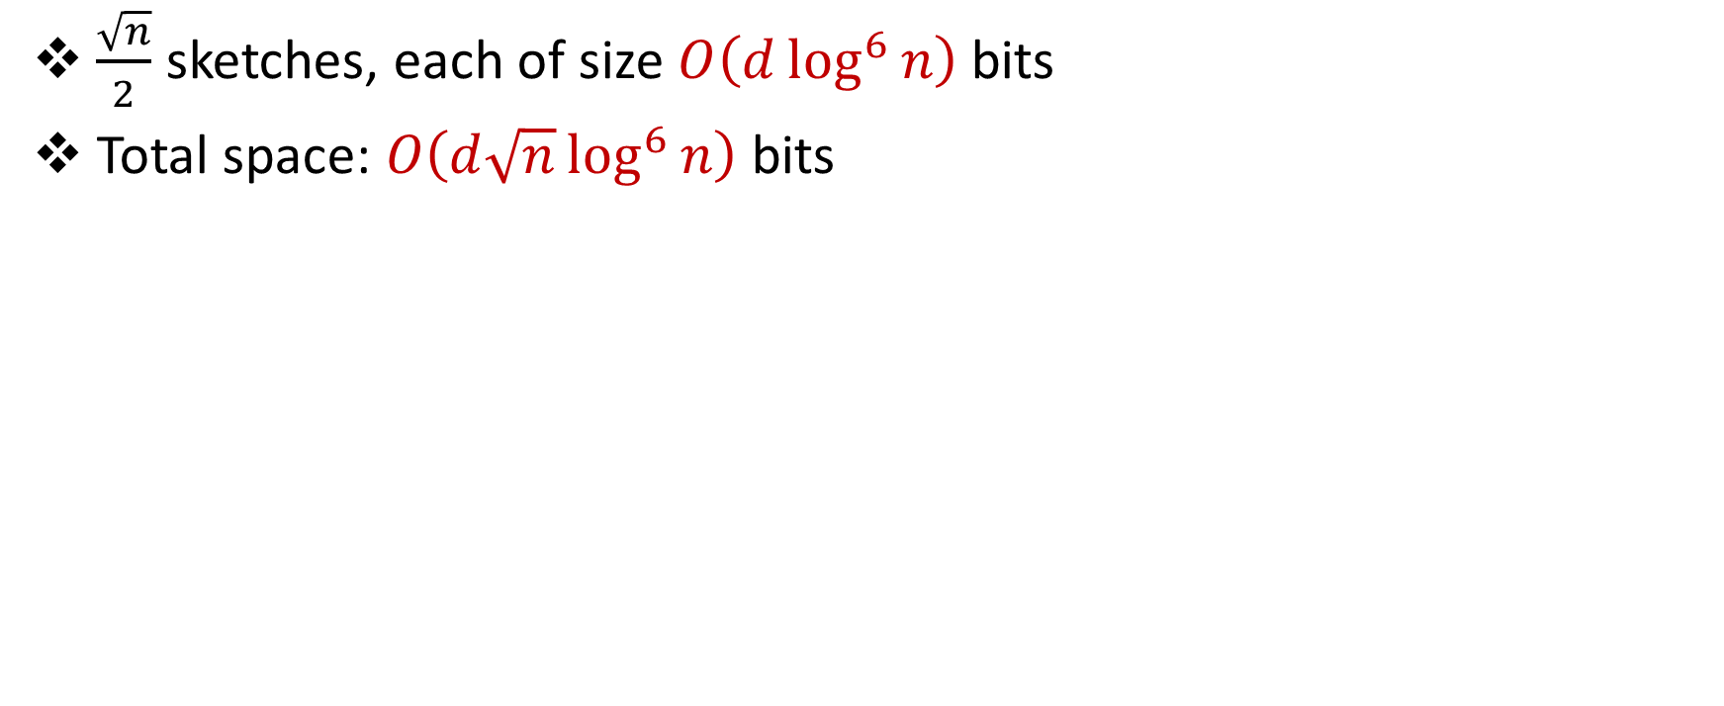
Additive Error Algorithm
$\frac{\sqrt{n}}{2}$ sketches, each of size $O\left(d\log^{6}{n}\right)$ bits
Total space: $O\left(d\sqrt{n}\log^{6}{n}\right)$ bits

Slide 31
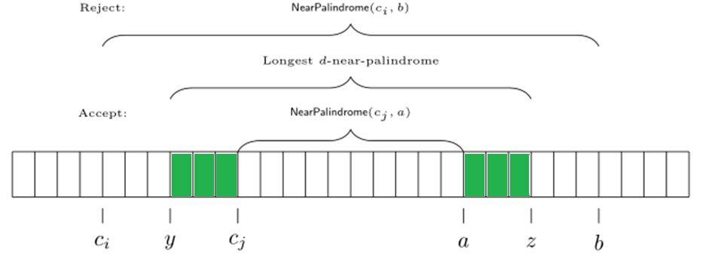
2-Pass Exact Algorithm
Can we modify 1-pass additive algorithm to 2-pass exact?
Missing characters before checkpoint!

Slide 32
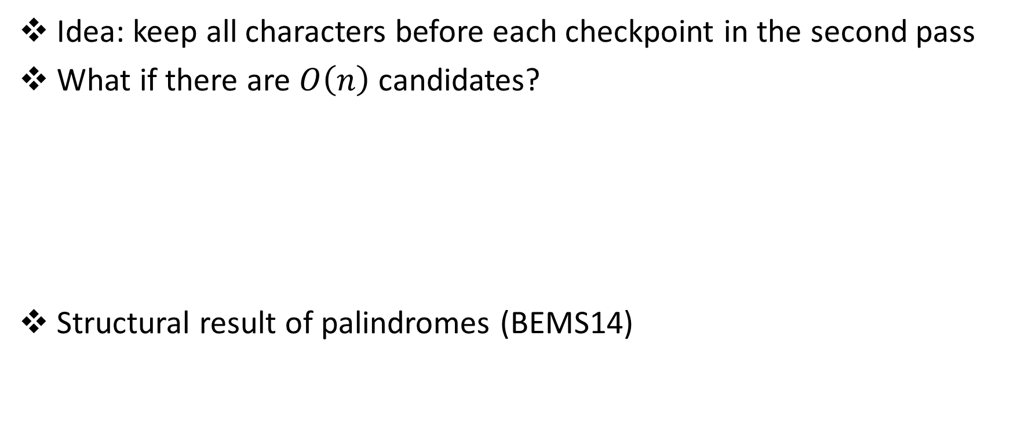
2-Pass Exact Algorithm
Idea: keep all characters before each checkpoint in the second pass
What if there are $O\left(n\right)$ candidates?
Structural result of palindromes (BEMS14)

Slide 33
Structural Result of Palindromes (BEMS14)

Slide 34
Structural Result of Palindromes (BEMS14)

Slide 35
Structural Result of Palindromes (BEMS14)

Slide 36
Structural Result of Palindromes (BEMS14)

Slide 37
Structural Result of Palindromes (BEMS14)

Slide 38
Structural Result of Palindromes (BEMS14)

Slide 39
Structural Result of Palindromes (BEMS14)

Slide 40
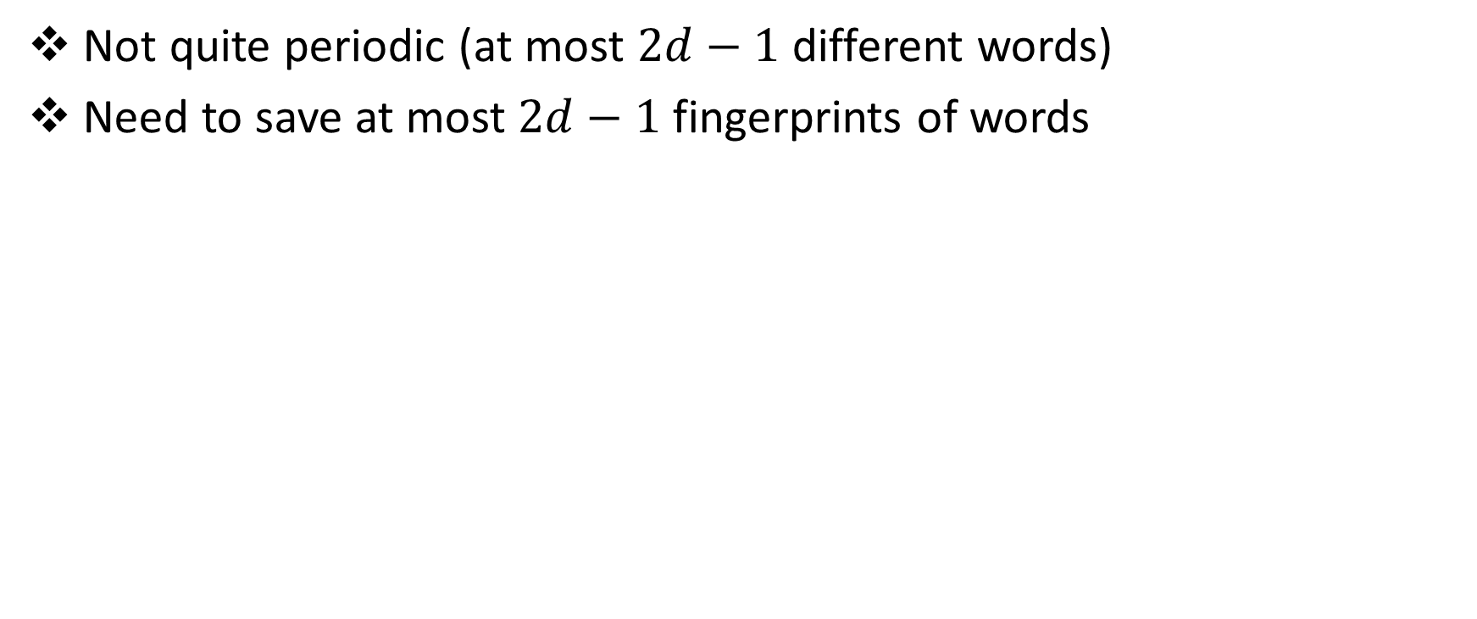
Structural Result of Near-Palindromes
Not quite periodic (at most $2d−1$ different words)
Need to save at most $2d−1$ fingerprints of words

Slide 41
2-Pass Exact Algorithm
Not quite periodic (at most $2d−1$ different words)
Need to save at most $2d−1$ fingerprints of words

Slide 42

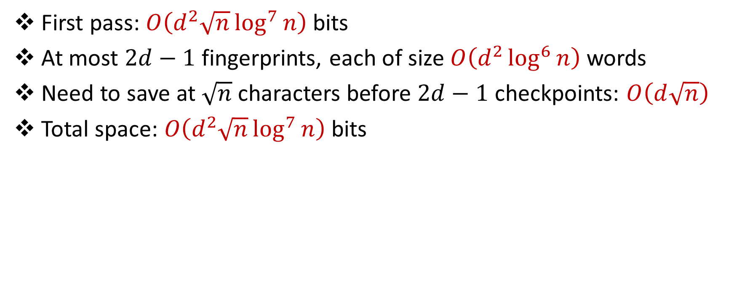
2-Pass Exact Algorithm
First pass: $O\left(d^{2}\sqrt{n}\log^{7}{n}\right)$ bits
At most $2d−1$ fingerprints, each of size $O\left(d^{2}\log^{6}{n}\right)$ words
Need to save at $\sqrt{n}$ characters before $2d−1$ checkpoints: $O\left(d\sqrt{n}\right)$
Total space: $O\left(d^{2}\sqrt{n}\log^{7}{n}\right)$ bits

Slide 43
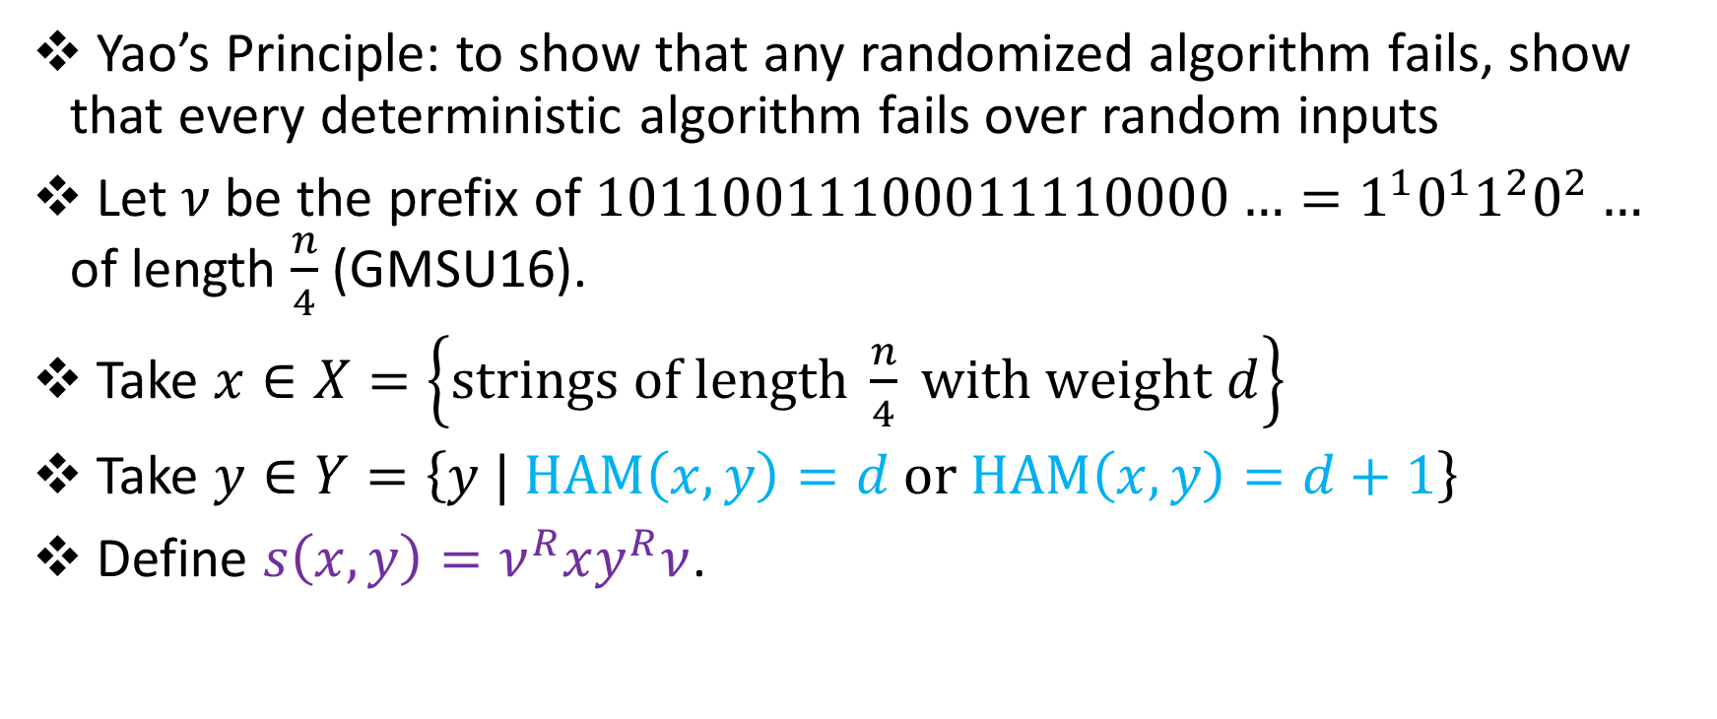
Multiplicative Lower Bounds
Yao’s Principle: to show that any randomized algorithm fails, show that every deterministic algorithm fails over random inputs
Let $ν$ be the prefix of $10110011100011110000…=1^{1}0^{1}1^{2}0^{2}…$ of length $\frac{n}{4}$ (GMSU16).
Take $x∈X=\left\{strings of length \frac{n}{4} with weight d\right\}$
Take $y∈Y=\left\{y | HAM\left(x,y\right)=d or HAM\left(x,y\right)=d+1\right\}$
Define $s\left(x,y\right)=ν^{R}xy^{R}ν$.

Slide 44
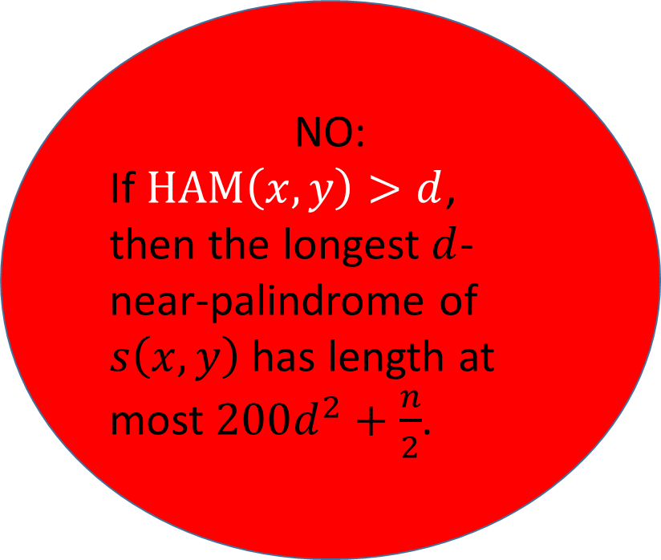
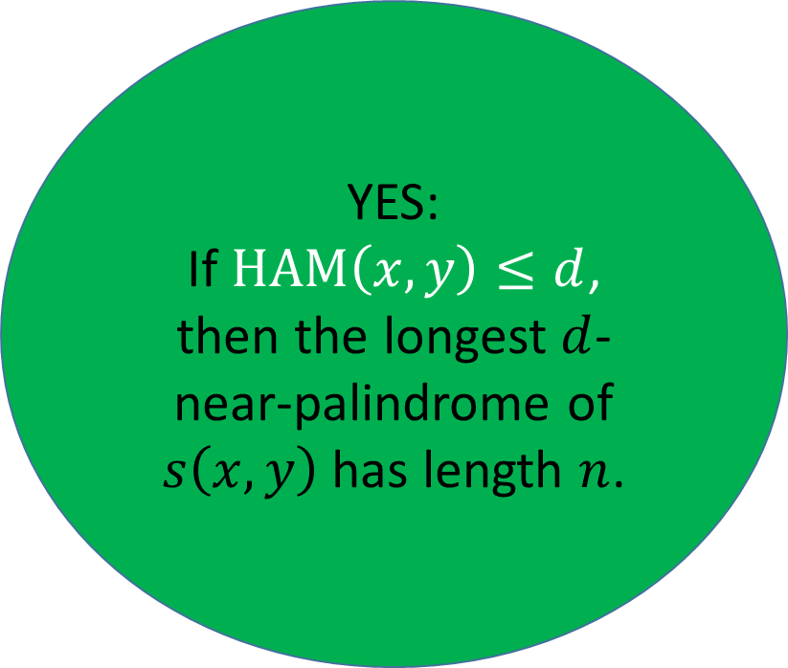
Multiplicative Lower Bounds
YES:
If $HAM\left(x,y\right)≤d$, then the longest $d$-near-palindrome of $s\left(x,y\right)$ has length $n$.
NO:
If $HAM\left(x,y\right)>d$, then the longest $d$-near-palindrome of $s\left(x,y\right)$ has length at most $200d^{2}+\frac{n}{2}$.

Slide 45
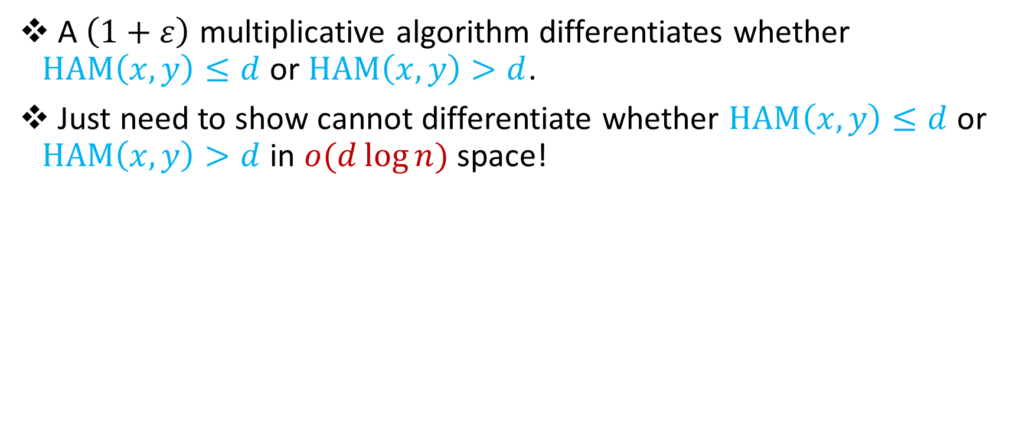
Multiplicative Lower Bounds
A $\left(1+ε\right)$ multiplicative algorithm differentiates whether $HAM\left(x,y\right)≤d$ or $HAM\left(x,y\right)>d$.
Just need to show cannot differentiate whether $HAM\left(x,y\right)≤d$ or $HAM\left(x,y\right)>d$ in $o(d\log{n)}$ space!

Slide 46

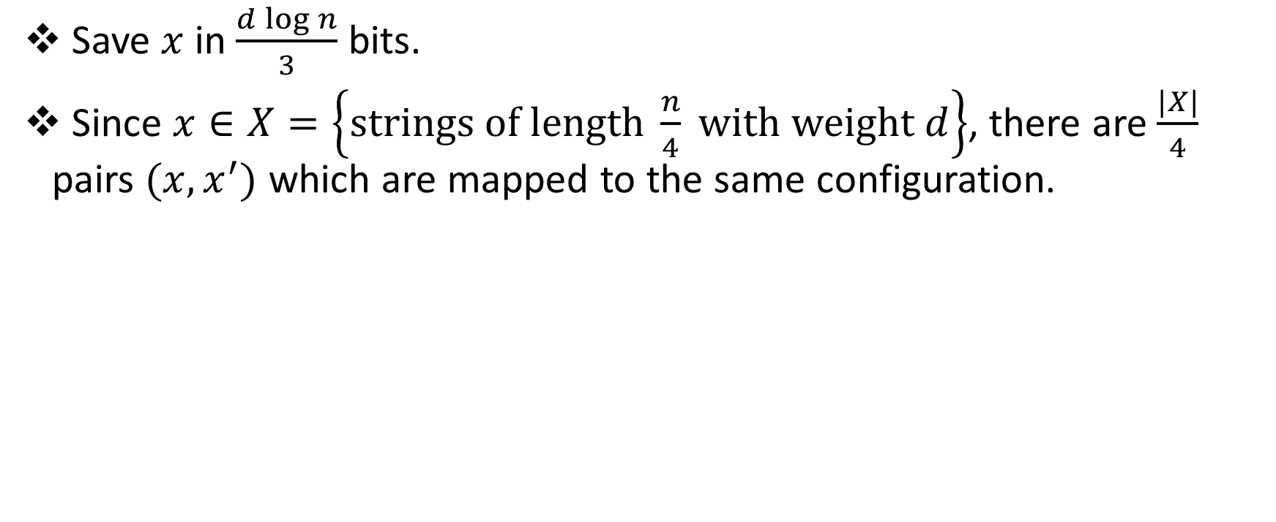
Multiplicative Lower Bounds
Save $x$ in $\frac{d\log{n}}{3}$ bits.
Since $x∈X=\left\{strings of length \frac{n}{4} with weight d\right\}$, there are $\frac{|X|}{4}$ pairs $(x,x^{′})$ which are mapped to the same configuration.

Slide 47
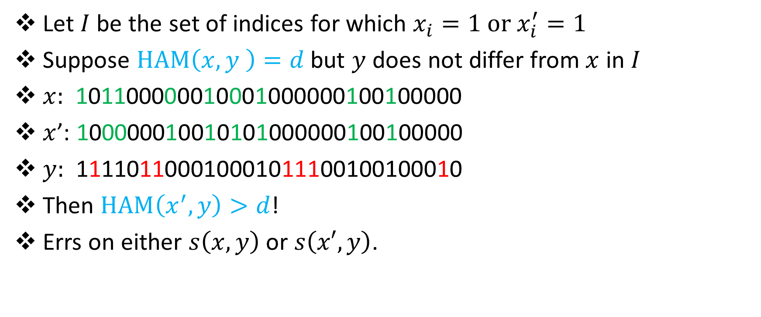
Multiplicative Lower Bounds
Let $I$ be the set of indices for which $x_{i}=1 or x_{i}^{′}=1$
Suppose $HAM\left(x,y \right)=d$ but $y$ does not differ from $x$ in $I$
$x:$ 101100000010001000000100100000
$x$’: 100000010010101000000100100000
$y:$ 111101100010001011100100100010
Then $HAM\left(x^{′},y\right)>d$!
Errs on either $s\left(x,y\right)$ or $s\left(x′,y\right)$.
???

Slide 48
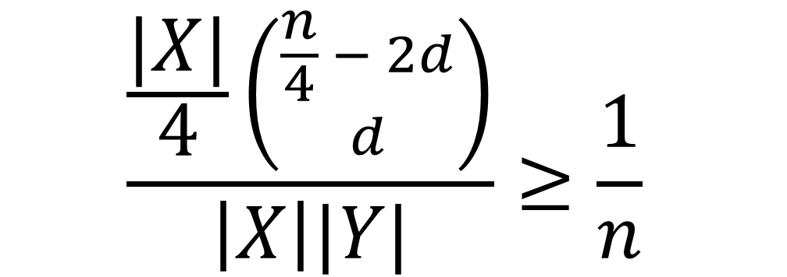
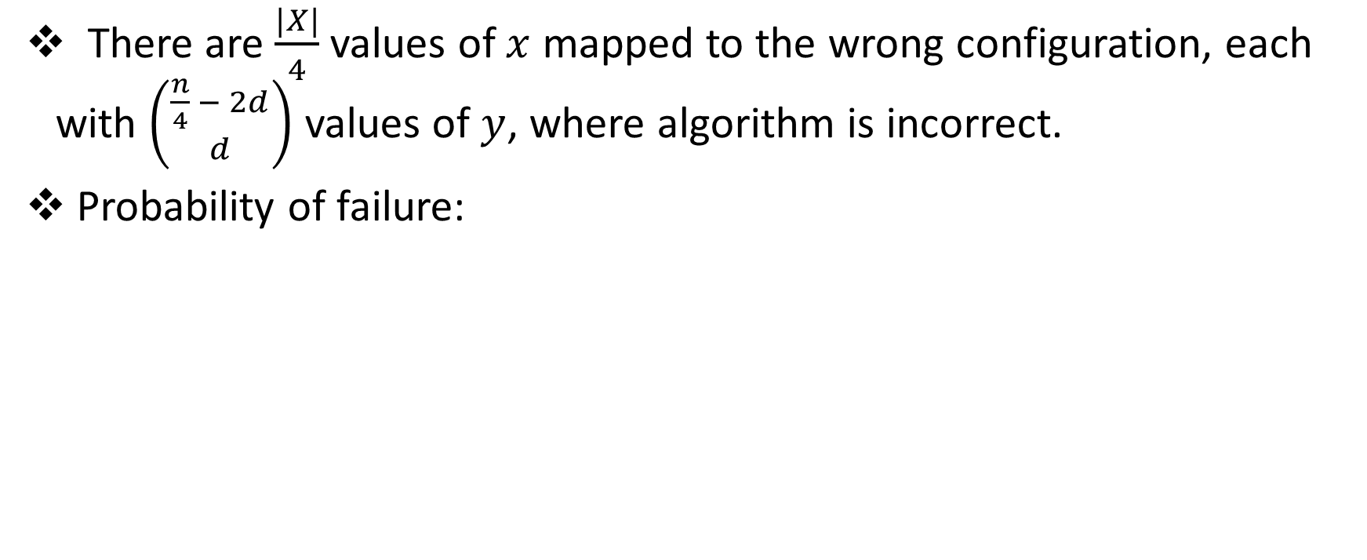
Multiplicative Lower Bounds
There are $\frac{|X|}{4}$ values of $x$ mapped to the wrong configuration, each with $\left({\frac{n}{4} − 2d \atop d}\right)$ values of $y$, where algorithm is incorrect.
Probability of failure:
$$\frac{\frac{|X|}{4}\left({\frac{n}{4} − 2d \atop d}\right)}{\left|X\right||Y|}≥\frac{1}{n}$$

Slide 49
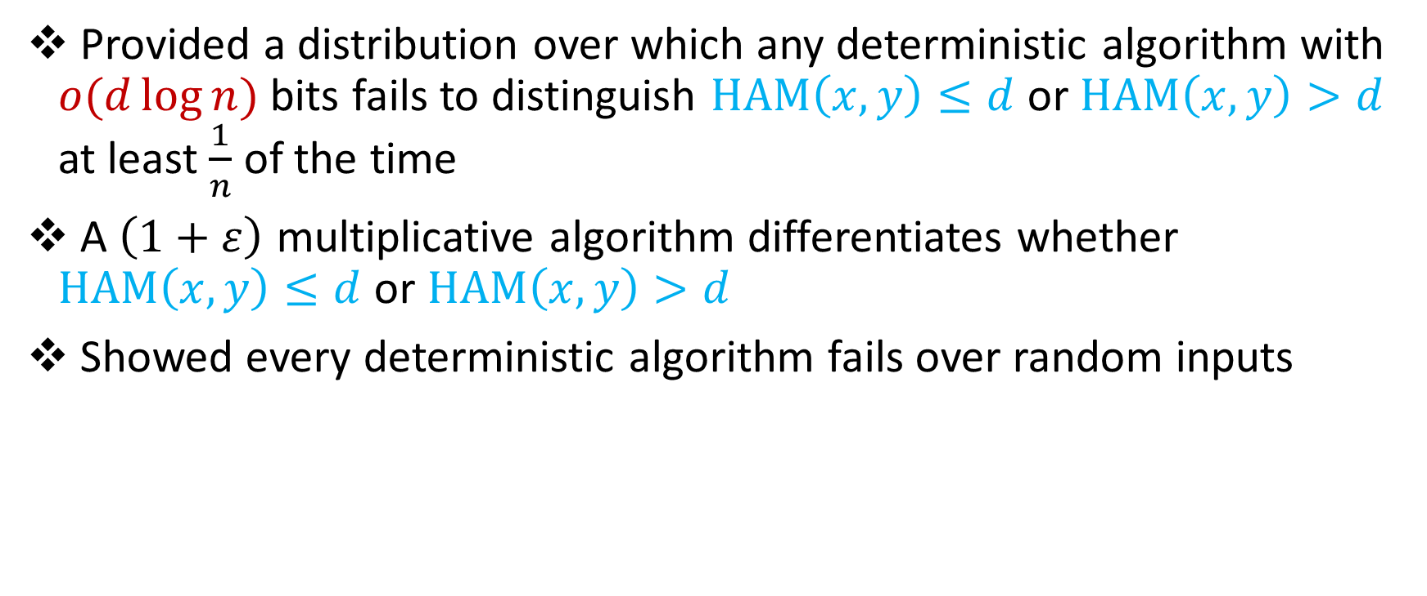
In review
Provided a distribution over which any deterministic algorithm with $o(d\log{n)}$ bits fails to distinguish $HAM\left(x,y\right)≤d$ or $HAM\left(x,y\right)>d$ at least $\frac{1}{n}$ of the time
A $\left(1+ε\right)$ multiplicative algorithm differentiates whether $HAM\left(x,y\right)≤d$ or $HAM\left(x,y\right)>d$
Showed every deterministic algorithm fails over random inputs

Slide 50
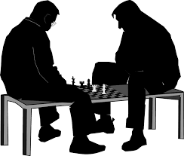
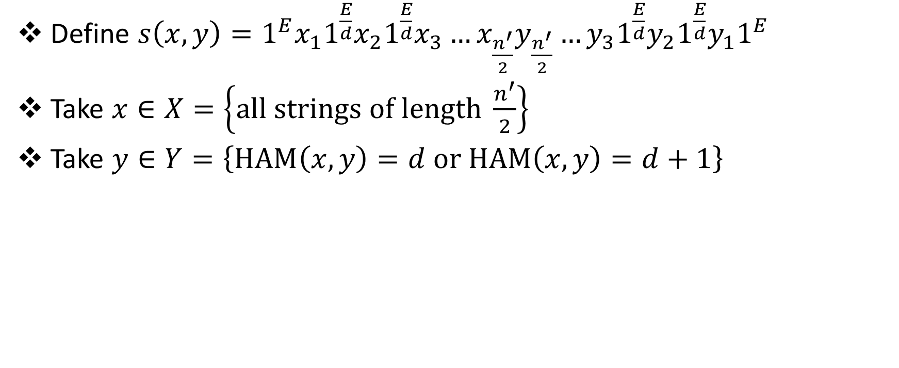
Additive Lower Bounds
Define $s\left(x,y\right)=1^{E}x_{1}1^{\frac{E}{d}}x_{2}1^{\frac{E}{d}}x_{3}…x_{\frac{n^{′}}{2}}y_{\frac{n^{′}}{2}}…y_{3}1^{\frac{E}{d}}y_{2}1^{\frac{E}{d}}y_{1}1^{E}$
Take $x∈X=\left\{all strings of length \frac{n^{′}}{2}\right\}$
Take $y∈Y=\left\{HAM\left(x,y\right)=d or HAM\left(x,y\right)=d+1\right\}$

Slide 51

Questions?

Slide 52
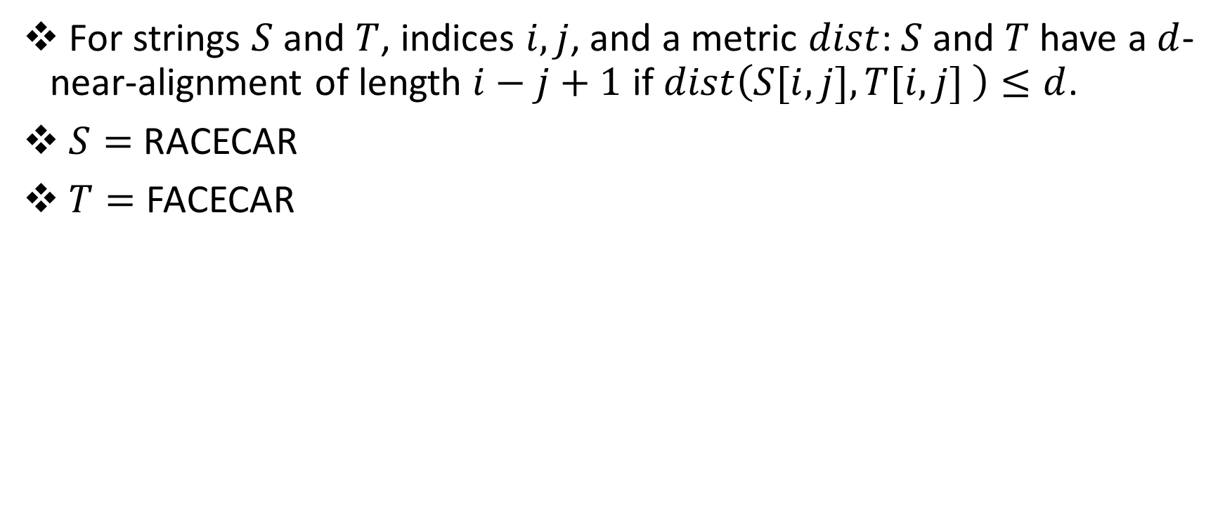
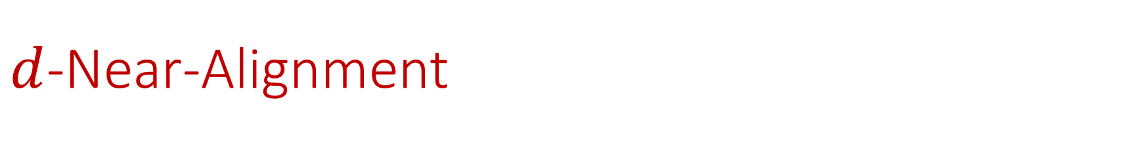
$d$-Near-Alignment
For strings $S$and $T$, indices $i,j$, and a metric $dist$: $S$and $T$ have a $d$-near-alignment of length $i−j+1$ if $dist\left(S[i,j],T[i,j] \right)≤d$.
$S=$ RACECAR
$T=$ FACECAR

Slide 53
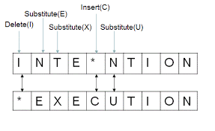
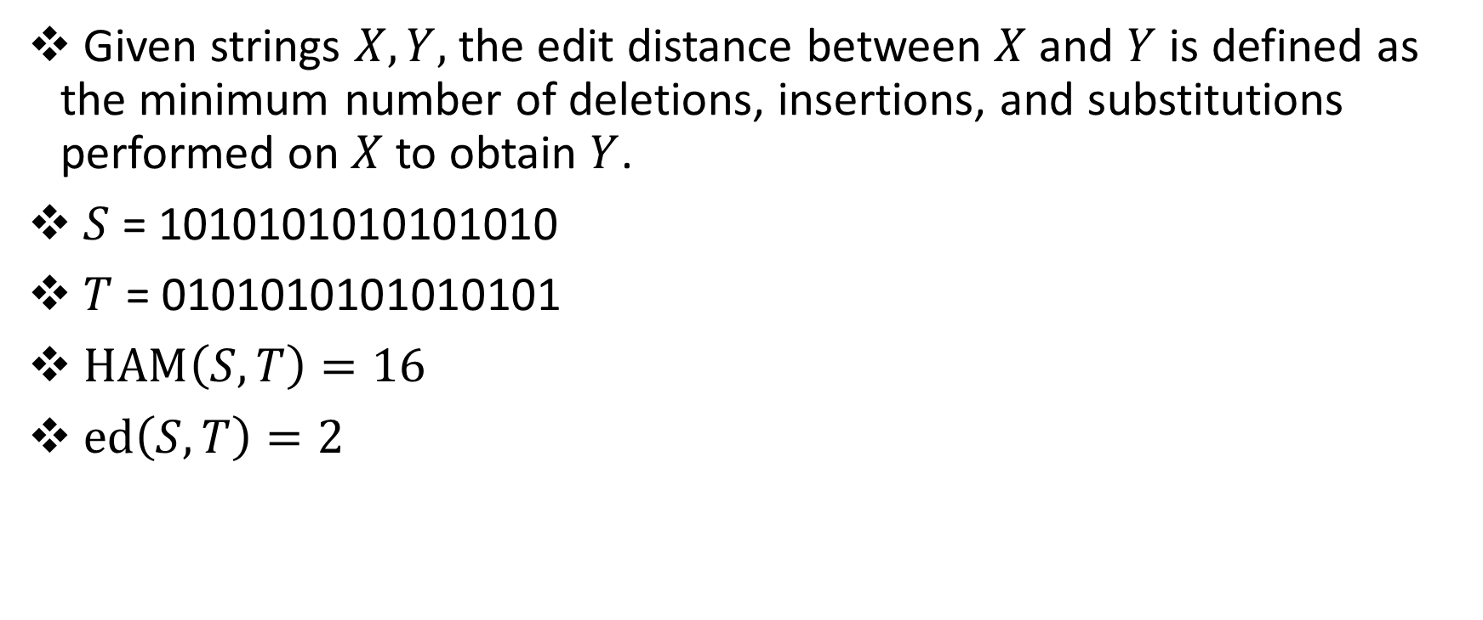
Edit (Levenshtein) Distance
Given strings $X, Y,$ the edit distance between $X$and $Y$ is defined as the minimum number of deletions, insertions, and substitutions performed on $X$ to obtain $Y$.
$S$ = 1010101010101010
$T$ = 0101010101010101
$HAM\left(S, T\right)=16$
$ed\left(S, T\right)=2$

Slide 54

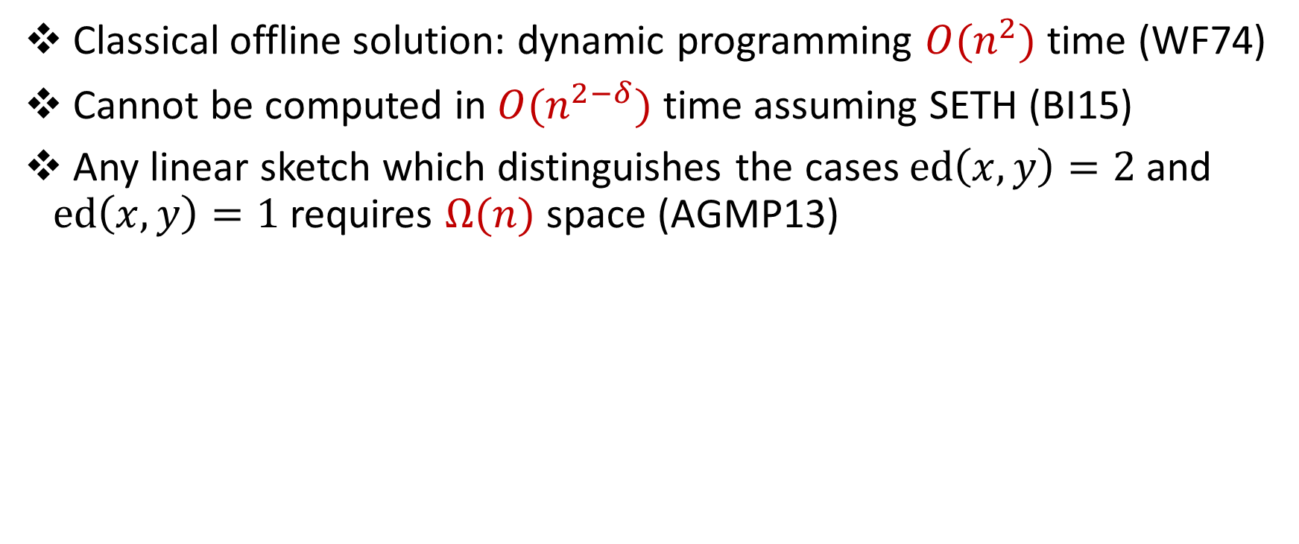
Edit (Levenshtein) Distance
Classical offline solution: dynamic programming $O(n^{2})$ time (WF74)
Cannot be computed in $O(n^{2−δ})$ time assuming SETH (BI15)
Any linear sketch which distinguishes the cases $ed\left(x,y\right)=2$ and $ed\left(x,y\right)=1$ requires $Ω(n)$ space (AGMP13)

Slide 55
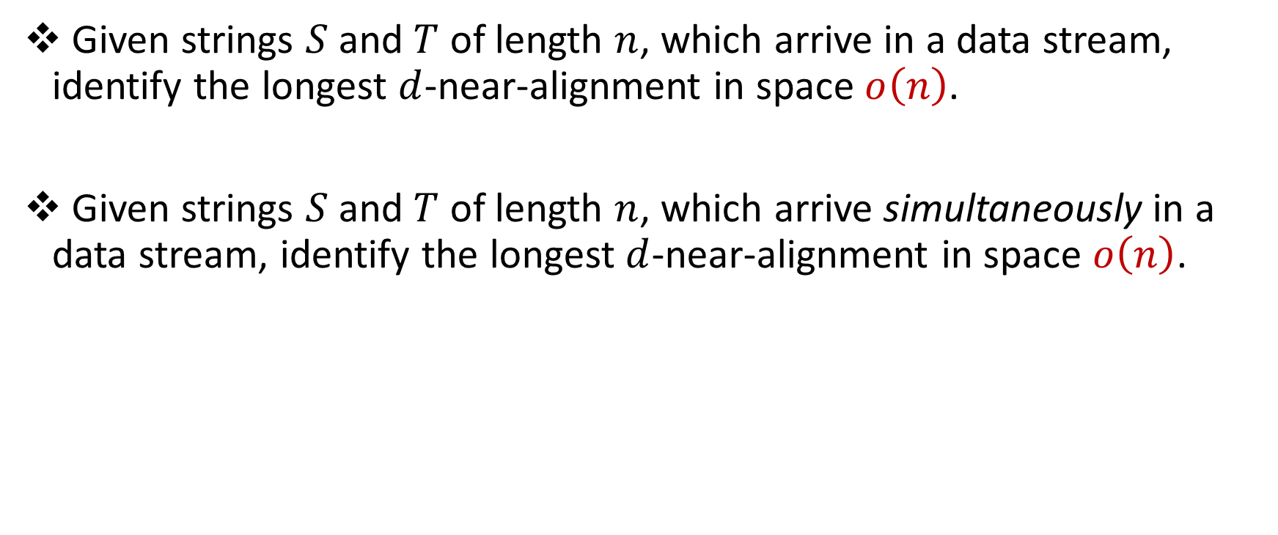
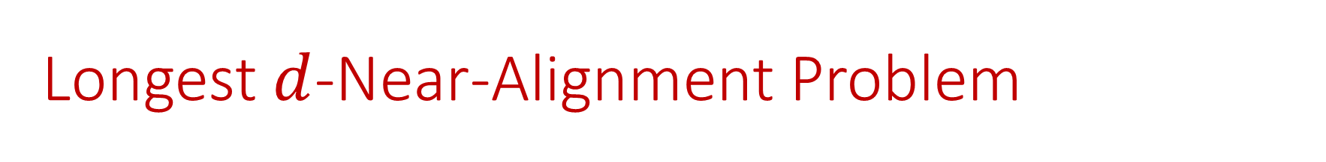
Longest $d$-Near-Alignment Problem
Given strings $S$ and $T$ of length $n$, which arrive in a data stream, identify the longest $d$-near-alignment in space $o\left(n\right)$.
Given strings $S$ and $T$ of length $n$, which arrive simultaneously in a data stream, identify the longest $d$-near-alignment in space $o\left(n\right)$.

Slide 56
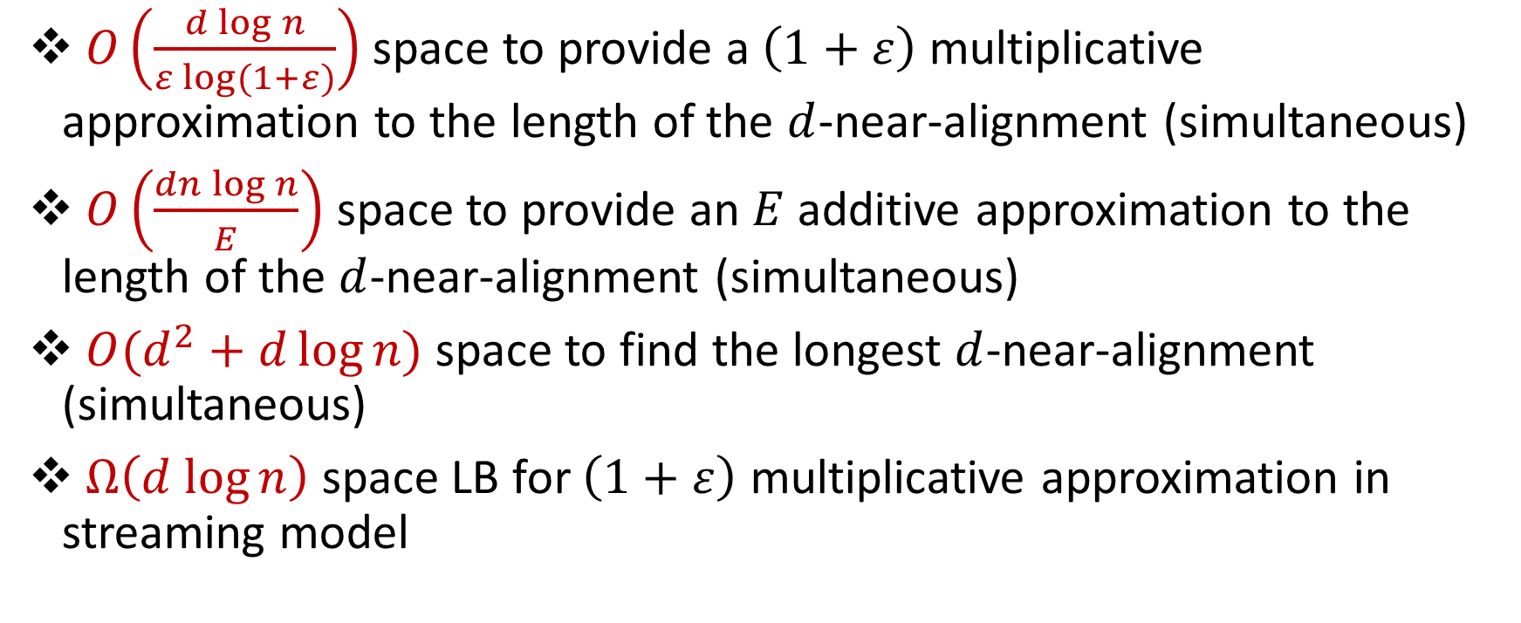
Results (All Edit Distance)
$O\left(\frac{d{\log{n}}}{ε log⁡(1+ε)}\right)$ space to provide a $\left(1+ε\right)$ multiplicative approximation to the length of the $d$-near-alignment (simultaneous)
$O\left(\frac{dn\log{n}}{E}\right)$ space to provide an $E$ additive approximation to the length of the $d$-near-alignment (simultaneous)
$O(d^{2}+d\log{n})$ space to find the longest $d$-near-alignment (simultaneous)
$Ω\left(d log{n}\right)$ space LB for $\left(1+ε\right)$ multiplicative approximation in streaming model

Slide 57


Longest $d$-Near-Alignment
Observation #1: If $d+1$ consecutive characters in $S$ are matched to $d+1$ consecutive characters in $T$, no character before the region can be matched to a character after the region by any other alignment

Slide 58


Longest $d$-Near-Alignment
Observation #2: If ${\left(d+1\right)}^{2}$ consecutive characters in $S$ and $T$does not contain a region (of length $d+1$), then it requires $d$ edit operations to be aligned

Slide 59

Longest $d$-Near-Alignment
Sliding window of size ${\left(d+1\right)}^{2}$ identifies either the most recent region or the most recent $d$ edit operations

Slide 60

Longest $d$-Near-Alignment
Algorithm keeps the most recent $d$ edit operations, location of the latest region, and the sliding window of size ${\left(d+1\right)}^{2}$
Edit operations before the region are fixed

Slide 61

Longest $d$-Near-Alignment
Window of size ${\left(d+1\right)}^{2}$
Locations of $d$ edit operations, each requiring space $O(\log{n)}$
Total space: $O(d^{2}+d log{n)}$

Slide 62
Questions?

Slide 63
Periodicity
A portion of a string that repeats
ABCDABCDABCDABCD
ABCDABCDABCDABCD

Slide 64

Periodicity
Alternate definition: prefix is the same as suffix
If $S$ has length $n$, and $S\left[1:n−p\right]=S\left[p+1:n\right]$, then we say $S$ has period $p$.
ABCDABCDABCDABCD
ABCDABCDABCD
ABCDABCDABCD
ABCDABCDABCDABCD

Slide 65

Hamming Distance
Given strings $X, Y,$ the Hamming distance between $X$and $Y$ is defined as the positions $i$ at which $X_{i}≠Y_{i}$.
$S$ = HAMMING
$T$ = FALLING
$HAM(S,T)=3$

Slide 66


$k$-Periodicity
A string that is “almost” periodic, robust to $k$ changes.
Periodicity: $S\left[1:n−p\right]=S\left[p+1:n\right]$
$k$-Periodicity: $HAM\left(S\left[1:n−p\right],S\left[p+1,n\right]\right)≤k.$
ABCDABCDABCEABCE
ABCDABCDABCEABCE
ABCDABCDABCE
ABCDABCEABCE
ABCDABCDABCEABCE
Long term periodic changes, but also encompasses “natural” definition.
1-period: 4

Slide 67


$k$-Periodicity Problem
Given a string $S$ of length $n$, which arrives in a data stream, identify the smallest $k$-period in space $o\left(n\right)$.
Given a string $S$ of length $n$, which arrives in a data stream, identify the smallest $k$-period in space $o\left(n\right)$, with two passes.

Slide 68

Related Work
$O(\log^{2}{n)}$ space to find the shortest period in one-pass, if $p≤\frac{n}{2}$. (ErgunJowhariSaglam10)
$Ω\left(n\right)$ space to find the period in one-pass, if $p>\frac{n}{2}$. (EJS10)
$O(\log^{2}{n)}$ space to find the shortest period in two-passes, even if $p>\frac{n}{2}$. (EJS10)
$k$-Mismatch Problem: $O\left(k^{2}\log^{8}{n}\right)$ space to find all instances of a pattern $P$ within a text $T$ with up to $k$ errors. (CliffordFontainePoratSachStarikovskaya16)

Slide 69


$k$-Periodicity (Our results)
$O({k^{4} log}^{9}{n)}$ space to find the shortest $k$-period in one-pass, if $p≤\frac{n}{2}$ .
$O({k^{4} log}^{9}{n)}$ space to find the shortest $k$-period in two-passes, even if $p>\frac{n}{2}$ .
$Ω\left(n\right)$ space to find the $k$-period, if $p>\frac{n}{2}$ , in one-pass.
$Ω\left(k\log{n}\right)$ space to find the $k$-period, even if $p≤\frac{n}{2}$ , in one-pass.

Slide 70

Ideas from Streaming Periodicity
A period $p$ satisfies $S\left[1:n−p\right]=S\left[p+1,n\right]$ .
If $p≤\frac{n}{2}$ , then $S\left[1:\frac{n}{2}\right]=S\left[p+1,p+\frac{n}{2}\right]$ .
ABCDABCDABCDABCD
ABCDABCDABCDABCD
ABCDABCDABCDABCD
ABCDABCDABCDABCD
If $p>\frac{n}{2}$ , then for some $m$, $S\left[1:2^{m}\right]=S\left[p+1,p+2^{m}\right]$ .

Slide 71
Karp-Rabin Fingerprints
Given base $B$and a prime $P$, define $φ\left(S\right)=\sum_{i=1}^{n}{B^{i}S\left[i\right] \left(mod P\right)}$
If $S=T$, then $φ\left(S\right)=φ\left(T\right)$
If $S≠T$, then $φ\left(S\right)≠φ\left(T\right)$ w.h.p. (Schwartz-Zippel)

Slide 72

Ideas from Streaming Periodicity
First pass: Find all positions $p$such that first $\frac{n}{2}$ characters match.
$S\left[1:\frac{n}{2}\right]=S\left[p+1,p+\frac{n}{2}\right]$ .
ABCDABCDABCDABCD
ABCDABCDABCDABCD
Second pass: For each $p,$ check whether $p$ is a $k$-period.
$S\left[1:n−p\right]=S\left[p+1,n\right]$ .
ABCDABCDABCDABCD
ABCDABCDABCDABCD

Slide 73

Overall Idea
A period $p$ satisfies $HAM\left(S\left[1:n−p\right],S\left[p+1,n\right]\right)≤k$.
If $p≤\frac{n}{2}$, then $HAM\left(S\left[1:\frac{n}{2}\right],S\left[p+1,p+\frac{n}{2}\right]\right)≤k$.
First pass: Find all positions $p$ that match the first $\frac{n}{2}$ characters.
$HAM\left(S\left[1:\frac{n}{2}\right],S\left[p+1,p+\frac{n}{2}\right]\right)≤k$.
Second pass: For each $p,$ check whether $p$ is a $k$-period.
$HAM\left(S\left[1:n−p\right],S\left[p+1,n\right]\right)≤k$.
Reduction to Pattern Matching / $k$-Mismatch

Slide 74



First Pass to Second Pass?
First pass: Find all positions $p$, “candidate” $k$-periods.
$HAM\left(S\left[1:\frac{n}{2}\right],S\left[p+1,p+\frac{n}{2}\right]\right)≤k$.
Second pass: For each $p,$ check whether $p$ is a $k$-period.
$HAM\left(S\left[1:n−p\right],S\left[p+1,n\right]\right)≤k$.
ABCDABCDABCDABCDABCD
Candidate positions $p=\left\{4,8,12,16,…\right\}$.
Candidates form an arithmetic progression!

Slide 75

First Pass to Second Pass?
If $p$ and $q$ are periods, then $d=gcd(p,q)$ is a period.
Does not work for $k$-periodicity!
AAAABA, $k=1$
$p=2$: AAAABA, AAAABA
AAAA
AABA
$p=3$: AAAABA, AAAABA
AAA
ABA
$p=1$: AAAABA, AAAABA
AAAAB
AAABA
1 mismatch
1 mismatch
2 mismatches!

Slide 76

First Pass to Second Pass?
Periodicity: Candidate positions $p=\left\{4,8,12,16,…\right\}$
What’s actually happening in the second pass?
Using $S\left[1:4\right]\text{,} S\left[5:8\right]$, $S\left[9:12\right]$,… to build $S\left[5:n\right]\text{,} S\left[9:n\right]$, $S\left[13:n\right]$,…
Can do this because $S\left[1:4\right]\text{,} S\left[5:8\right]$, $S\left[9:12\right]$ are all the same!
$k$-periodicity: Candidate positions $p=\left\{8,16,20,28,32…\right\}$?
Attempt: Candidate positions $p=\left\{4,8,12,16,20,24,28,32…\right\}$?
Can still do above construction if “most” of $S\left[1:4\right]\text{,} S\left[5:8\right]$, $S\left[9:12\right]$ are the same
Not sure if true…

Slide 77


First Pass to Second Pass?
Candidates $p=\left\{8,16,20,27,30,39,45,55\right\}$?
Candidates $p=\left\{8,12,16,20\},\left\{27,30,33,36,39\right\},\{45,50,55\right\}$

Slide 78

Structural Results
If $p$ and $q$ are periods, then $d=gcd(p,q)$ is a period.
If $p$ and $q$ are “small”, then $d=gcd(p,q)$ is a $O(k^{2})$-period.
At most $O\left(k^{2}\right)$ of the substrings $S\left[1:d\right],$ $S\left[d+1:2d\right],$ $S\left[2d+1:3d\right],$ can be different

Slide 79








Structural Results
If $p$ and $q$ are “small”, then $d=gcd(p,q)$ is a $O(k^{2})$-period.
Consider the indices as a grid.
If there are at most $k$ indices $i$ such that $S\left[i]≠S[i+p\right],$ and at most $k$ indices $j$ such that $S\left[j]≠S[j+q\right],$ then there are at most $O(k^{2})$ indices $l$ such that $S\left[l]≠S[l+d\right]$.
$$i+p$$
$$i−q$$
$$i$$
$$i+q$$
$$i−p$$

Slide 80






Structural Results
…AABAAABCCAA…
$p=3, q=7$
Bound the number of indices $l$ such that $S\left[l]≠S[l+d\right]$.
$$i+p$$
A
A
A
C
$$i−q$$
$$i$$
$$i+q$$
$$i−p$$

Slide 81


Structural Results
Connect adjacent points with edges.
“Good edge” if $S\left[i]=S[i+p\right]$.
“Bad edge” if $S\left[i]≠S[i+p\right]$.
If there exists a path from $i$to $j$ which “hops” along good edges, then $S\left[i\right]=S[j]$.
…AABAAABCCAA…
$p=3, q=7$
…AABAAABCCAA…
$$i+p$$
$$i+p+q$$
$$i−q$$
$$i$$
$$i+q$$
$$i−p$$

Slide 82


Structural Results
If there are at most $k$ indices $i$ such that $S\left[i]≠S[i+p\right],$ and at most $k$ indices $j$ such that $S\left[j]≠S[j+q\right],$ then there are at most $O(k^{2})$ indices $l$ such that $S\left[l]≠S[l+d\right]$.
$$i+p$$
$$i+p+q$$
Bound the number of indices $l$ such that $S\left[l]≠S[l+d\right]$.
If $S\left[l]≠S[l+d\right]$, then $l$ must be enclosed by bad edges.
There are at most $2k$ bad edges.
How many enclosed points can there be?
$$i−q$$
$$i$$
$$i+q$$
$$i−p$$

Slide 83


Structural Results
If there are at most $2k$ bad edges, there are $O(k^{2})$ enclosed points.
There are $O(k^{2})$ indices $l$ such that $S\left[l]≠S[l+d\right]$.

Slide 84

In review
If $p$ and $q$ are “small”, then $d=gcd(p,q)$ is a $O(k^{2})$-period.
Positions $p=\left\{8,16,20,27,30,39,45,55\right\}$?
Positions $p=\left\{8,12,16,20\},\left\{27,30,33,36,39\right\},\{45,50,55\right\}$

Slide 85

In review
First pass: Find all positions $p$such that
$HAM\left(S\left[1:\frac{n}{2}\right],S\left[p+1,p+\frac{n}{2}\right]\right)≤k$.
Second pass: For each $p,$ check if
$HAM\left(S\left[1:n−p\right],S\left[p+1,n\right]\right)≤k$.

Slide 86

Open Problems
What can we say about these problems with other distance metrics (particularly, edit distance)?
Can we improve the space usage? Specifically, the $k^{4}$ dependence comes from the structural property and the $k$-Mismatch Problem algorithm.
Can we find the longest $d$-near-alignment in space $o(d^{2})$?
Longest palindromic subsequence

Slide 87

Questions?

